Slide 1
Tree Based Methods:
Classification Trees
Team 2-18: Ethan Hu, Hang Su, Ryan Jin, Yang Li

Slide 2
Recap: regression trees
Recursive binary splitting
Notes:
Splitting based on numeric values

Slide 3
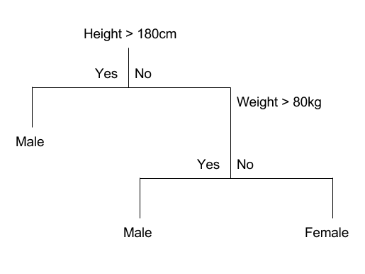
Definition: Classification tree
A classification tree labels, records, and assigns variables to discrete classes.
It is also built through recursive binary split.
Notes:
Exact same method as regression tree. The only difference is how we determine what a good split is. RSS in Regression, we use something else

Slide 4
Regression trees vs. Classification trees
 | Regression Trees | Classification Trees
Method | Used to predict a quantitative response | Used to predict a qualitative response
Prediction Value | Mean | Mode
Measures | RSS | Entropy/Gini
Notes:
Residual sum of squares

Slide 5
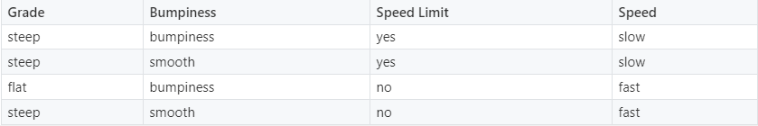
Building the classification tree
A training set is created where target is known for each data point
Assigns each data point to one of two subsets based on a feature (attribute)
Features
Target
Notes:
4 observations.
Independent variables, dependent variables
We are using these features to predict the label

Slide 6
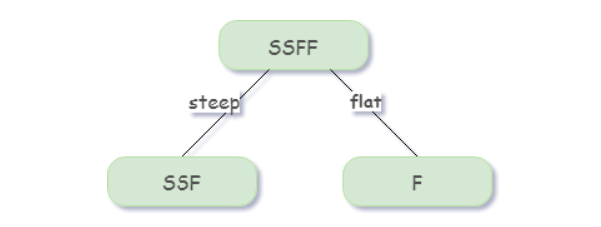
The Split
Feature: Grade
SSFF: Parent Node

Slide 7
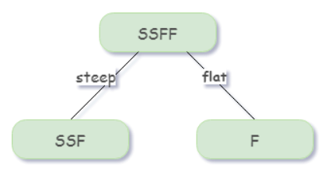
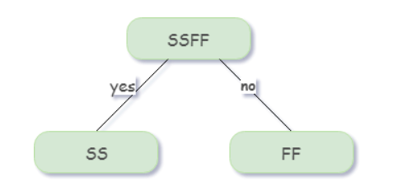
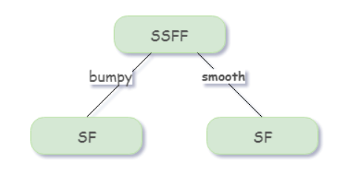
The Split
We want to maximize the purity of the groups every time we are splitting into two nodes.
Grade
Speed limit
Bumpiness
Notes:
Cleaniess

Slide 8
Initial Split
How do we decide which feature should be the basis for the initial split?

Slide 9
Entropy
Entropy is a measure of disorder.
It is an indicator of how messy your data is.

Slide 10
Entropy
Goal: to minimize entropy
At each step, we want to decrease the entropy, so the split that produces the greatest reduction in entropy is computed for each feature. And the best of these is chosen to be the split at this step.
This process continues until no further reduction in entropy can be achieved. This can happen, for example, when each leaf node contains only one class.
Notes:
On the figure below is depicted the splitting process. Red rings and blue crosses symbolize elements with 2 different labels. The decision starts by evaluating the feature values of the elements inside the initial set. Based on their values, elements are put in Set 1 or Set 2. In this example, after the splitting, the state seems tidier, most of the red rings have been put in Set 1 while a majority of blue crosses are in Set 2.

Slide 11
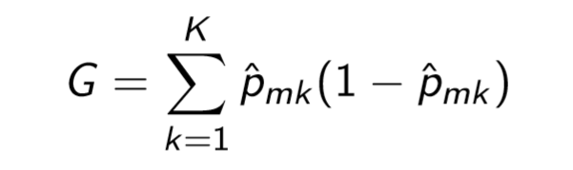
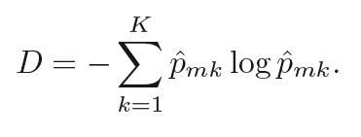
Gini index/ Entropy
Recall that ˆPmk represents the proportion of training observations in the region m that are from class k. The Gini index is deﬁned by:
An alternative to the Gini index is the cross entropy

Slide 12
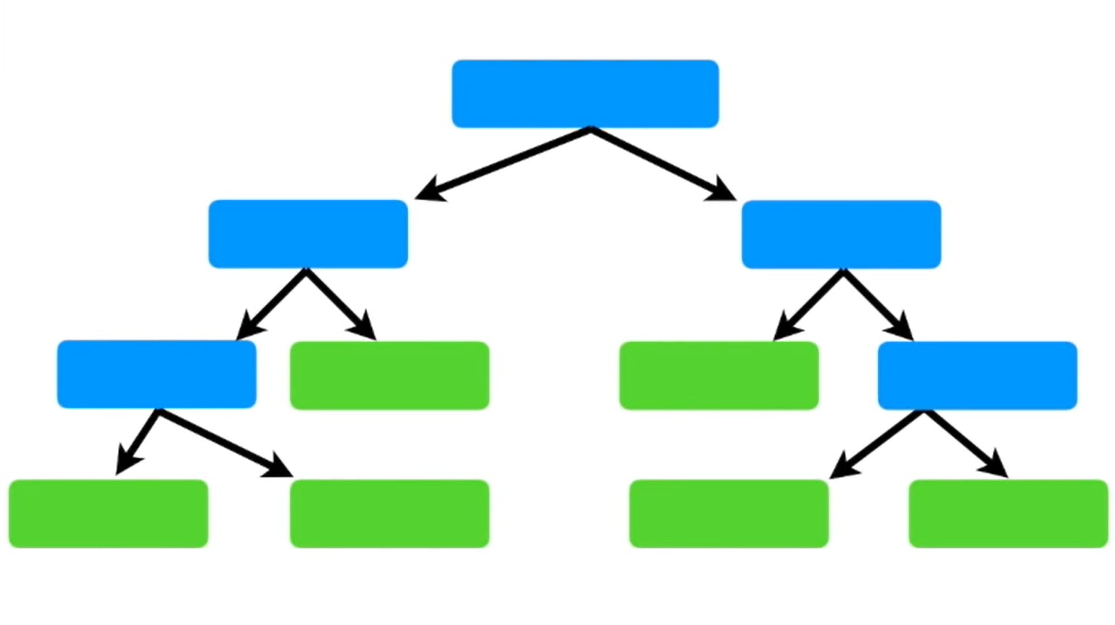
How to grow a classiﬁcation tree?
Top to bottom
Recursive
run recursively for every brunch
Greedy Algorithm
No backtracking
Binary split

Slide 13
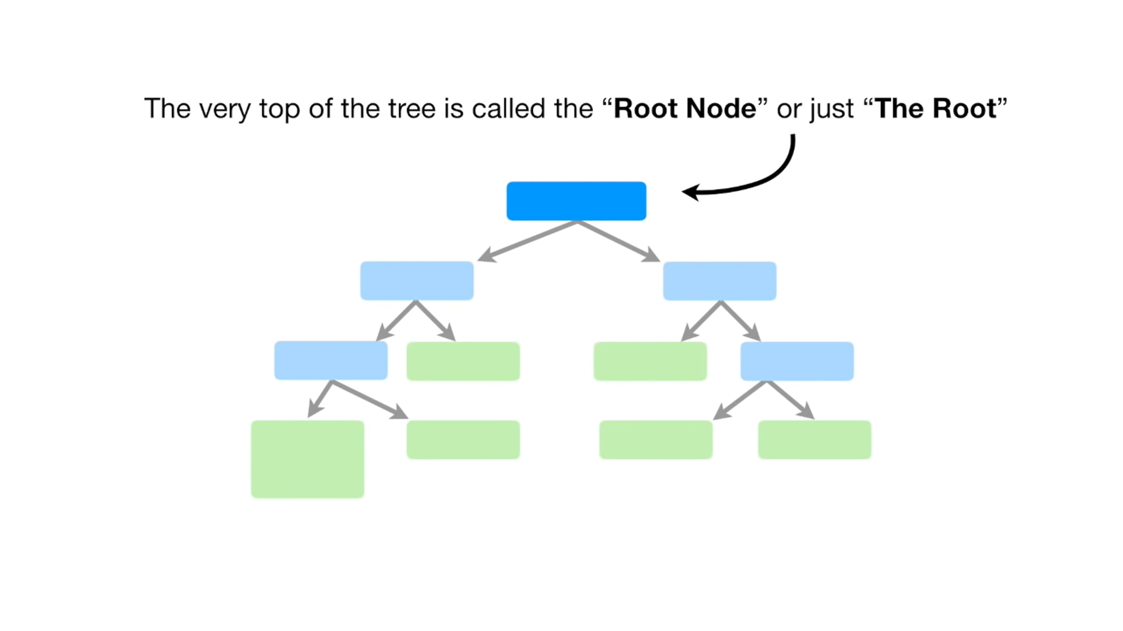

Slide 14
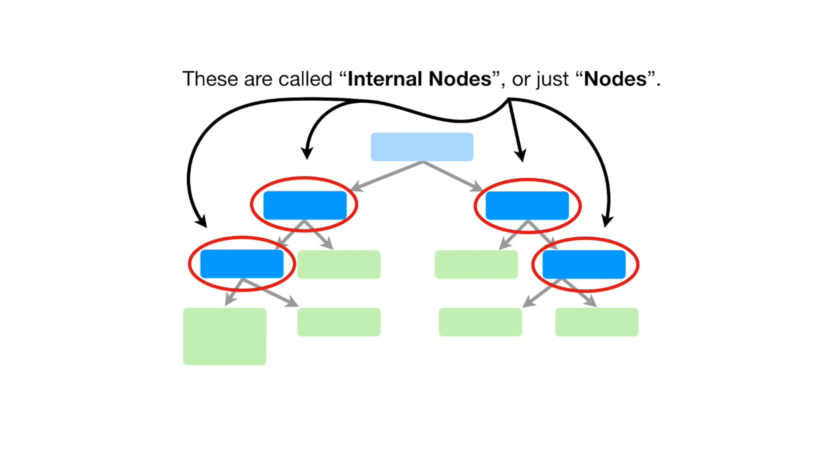

Slide 15
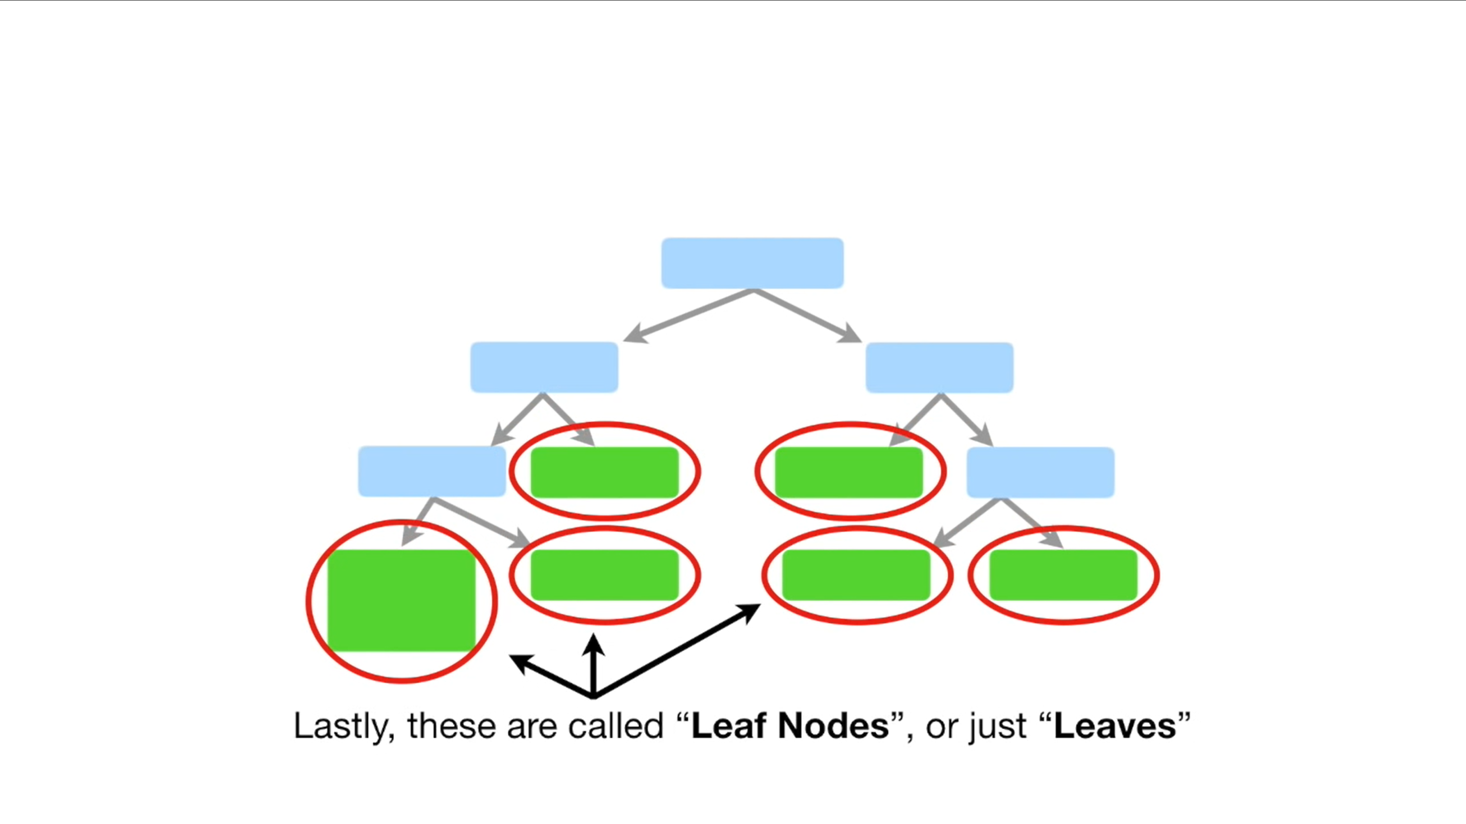

Slide 16
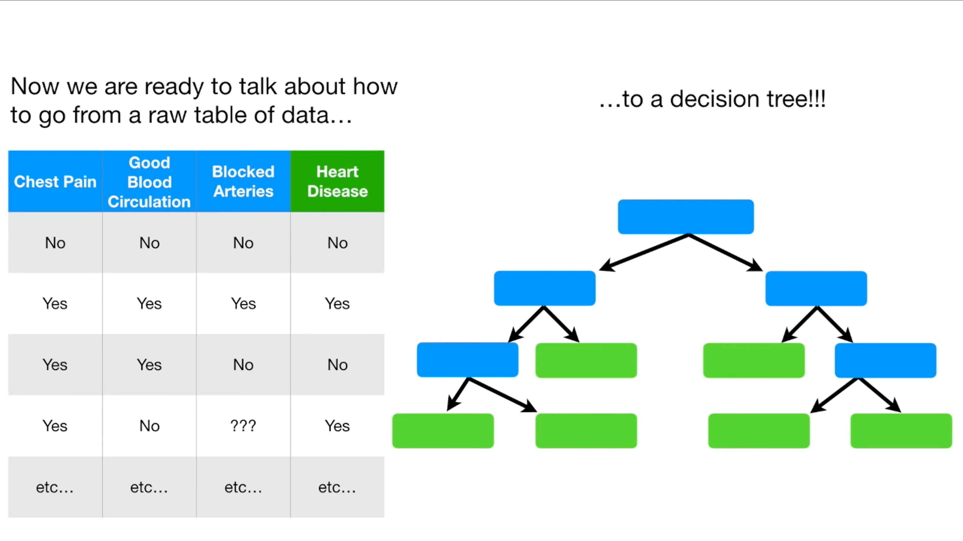

Slide 17
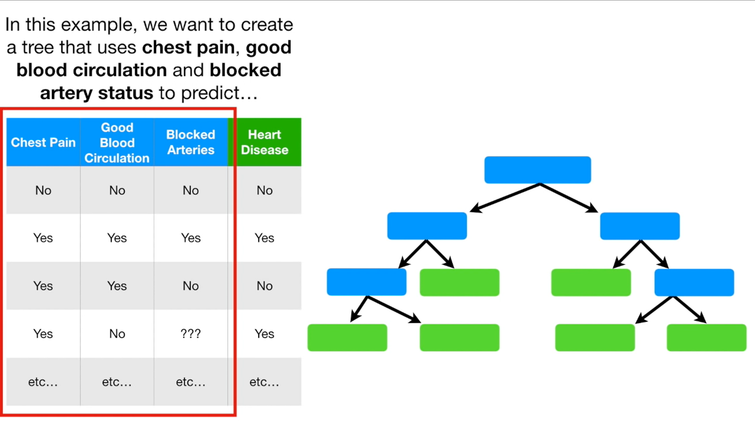

Slide 18
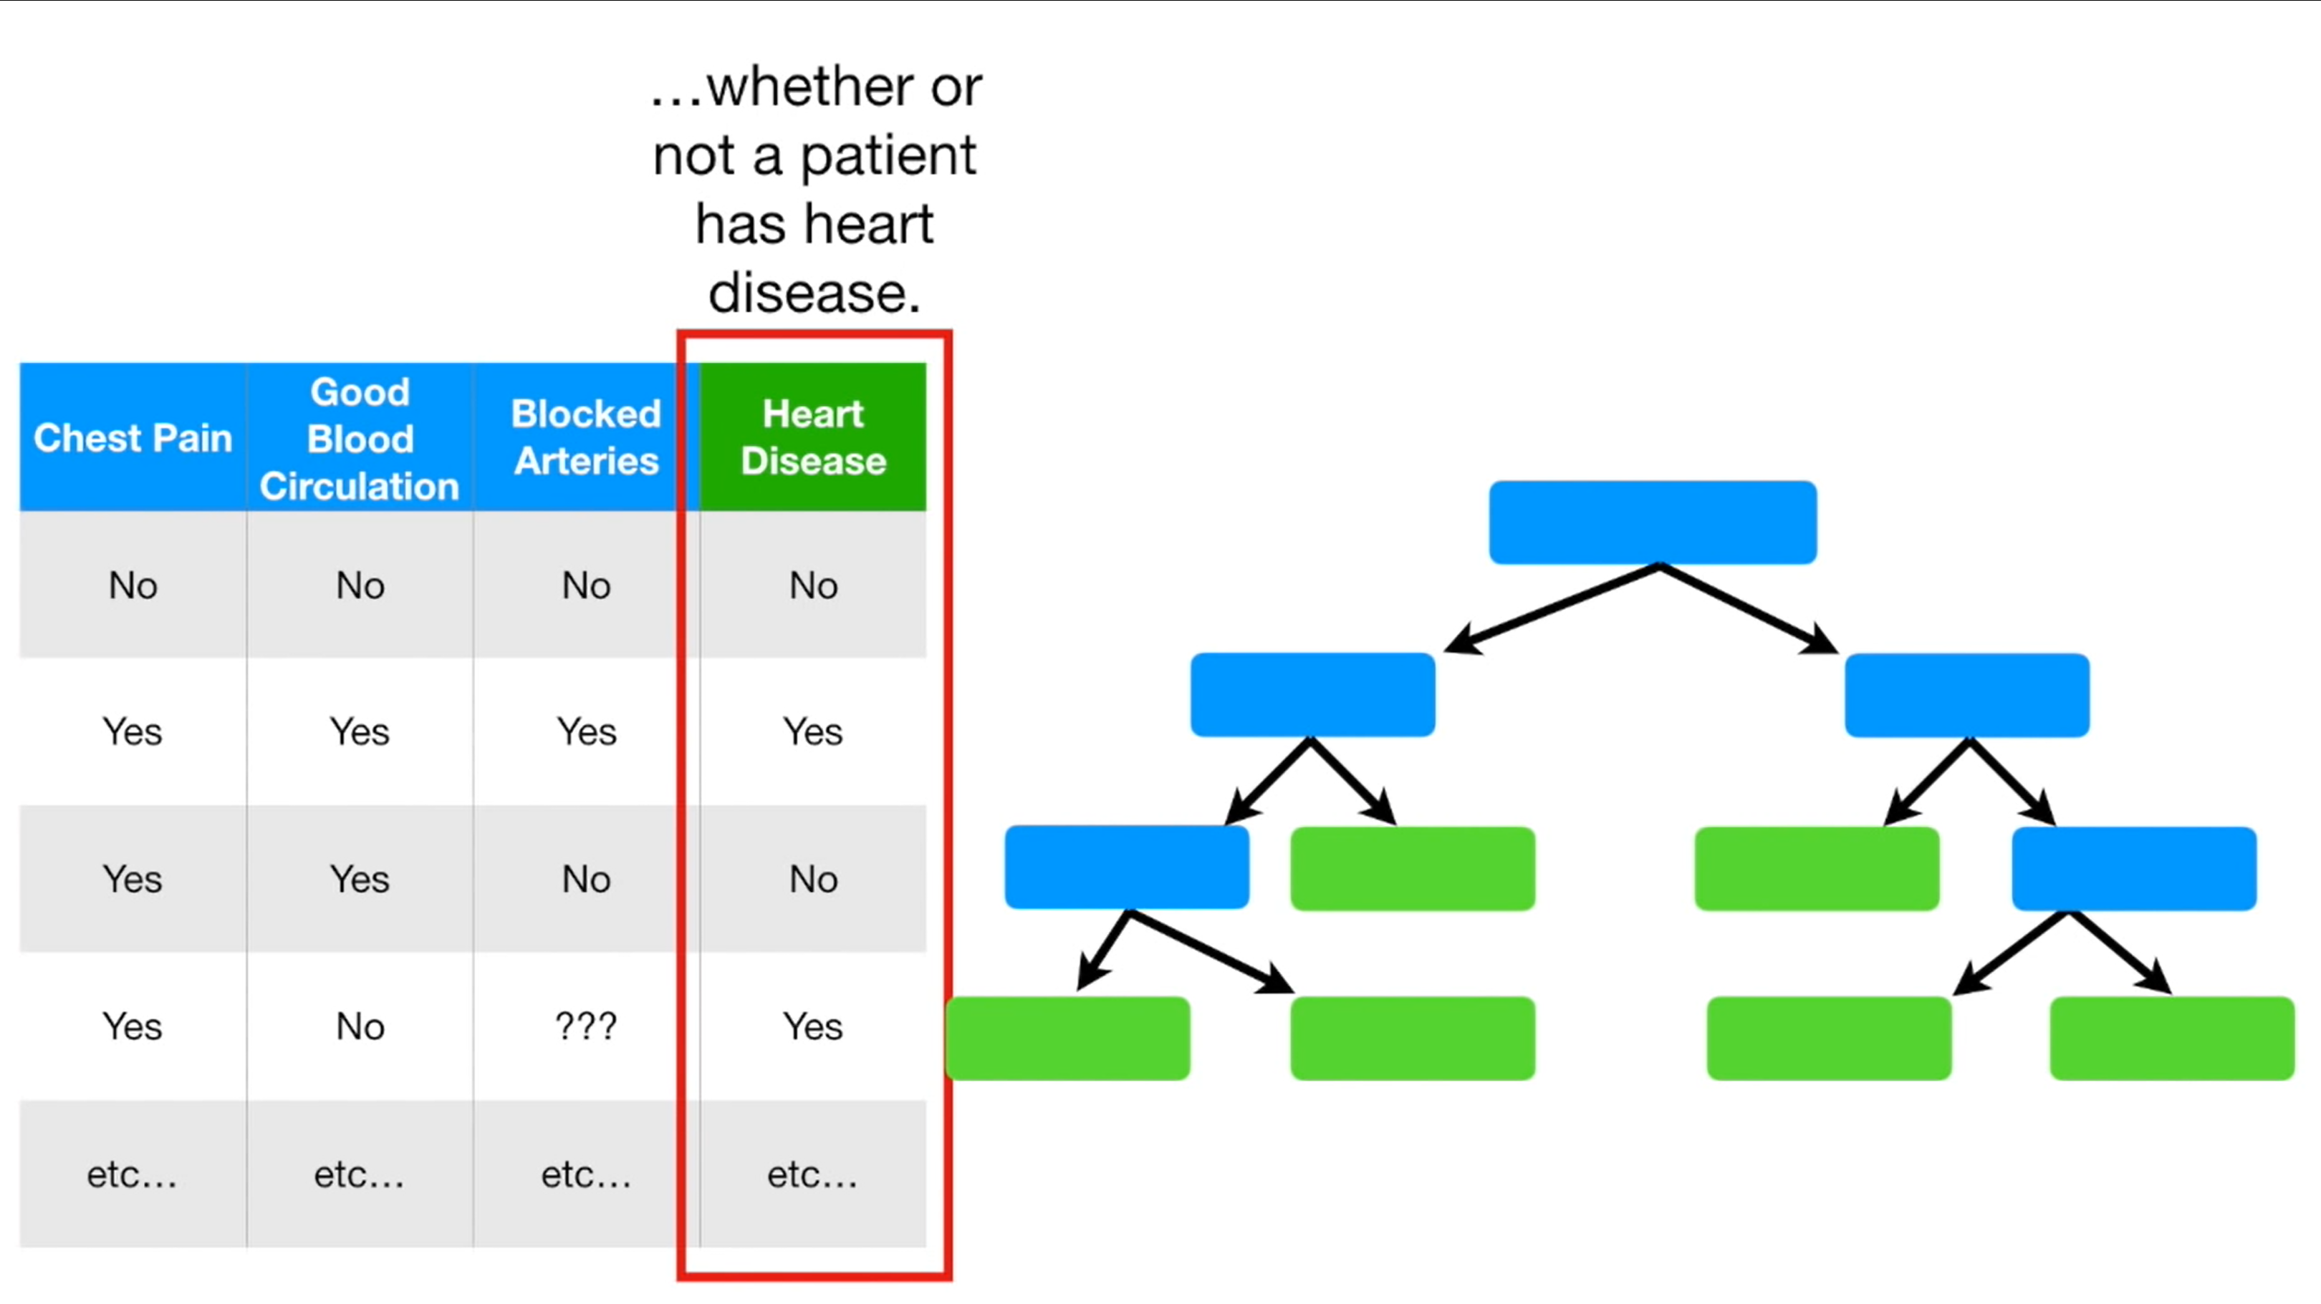

Slide 19
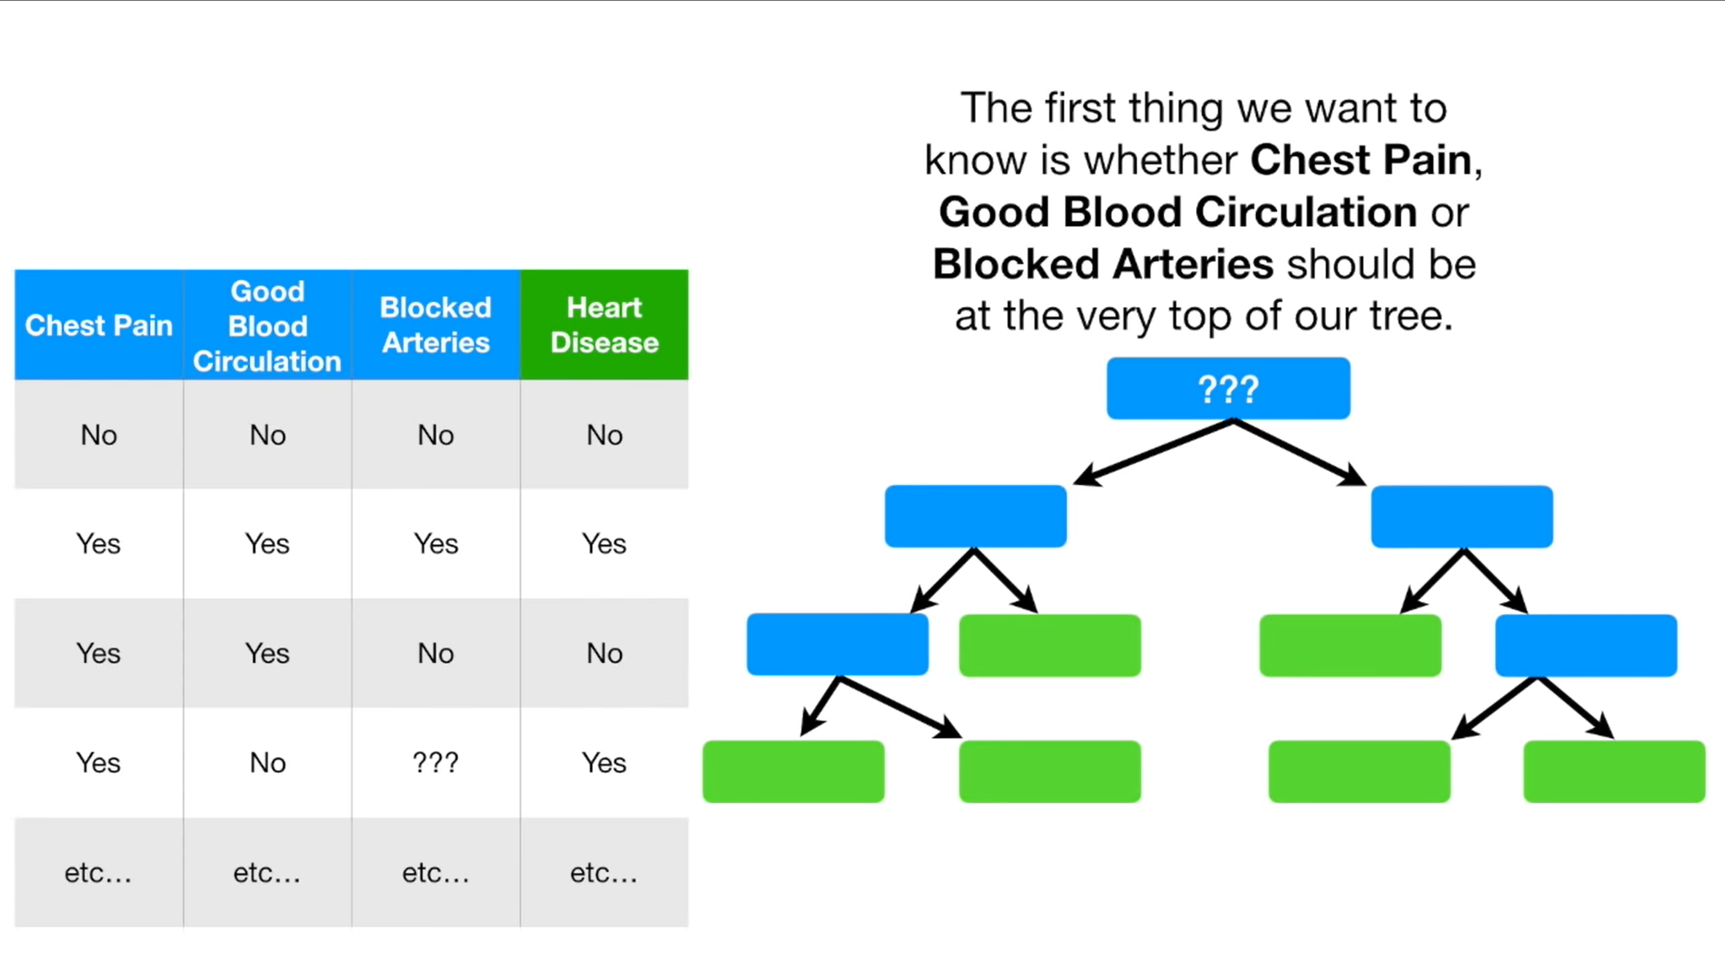

Slide 20
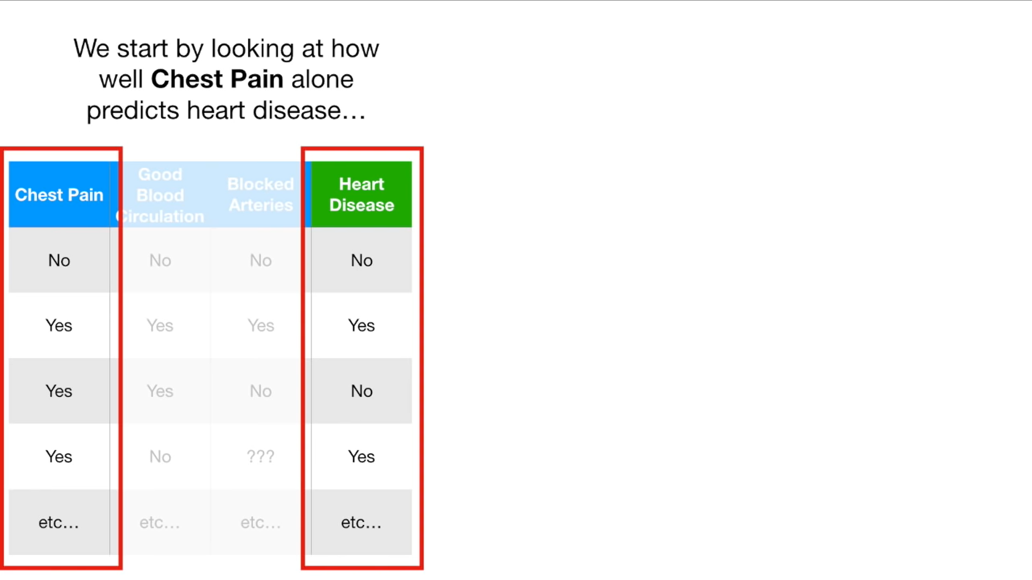

Slide 21
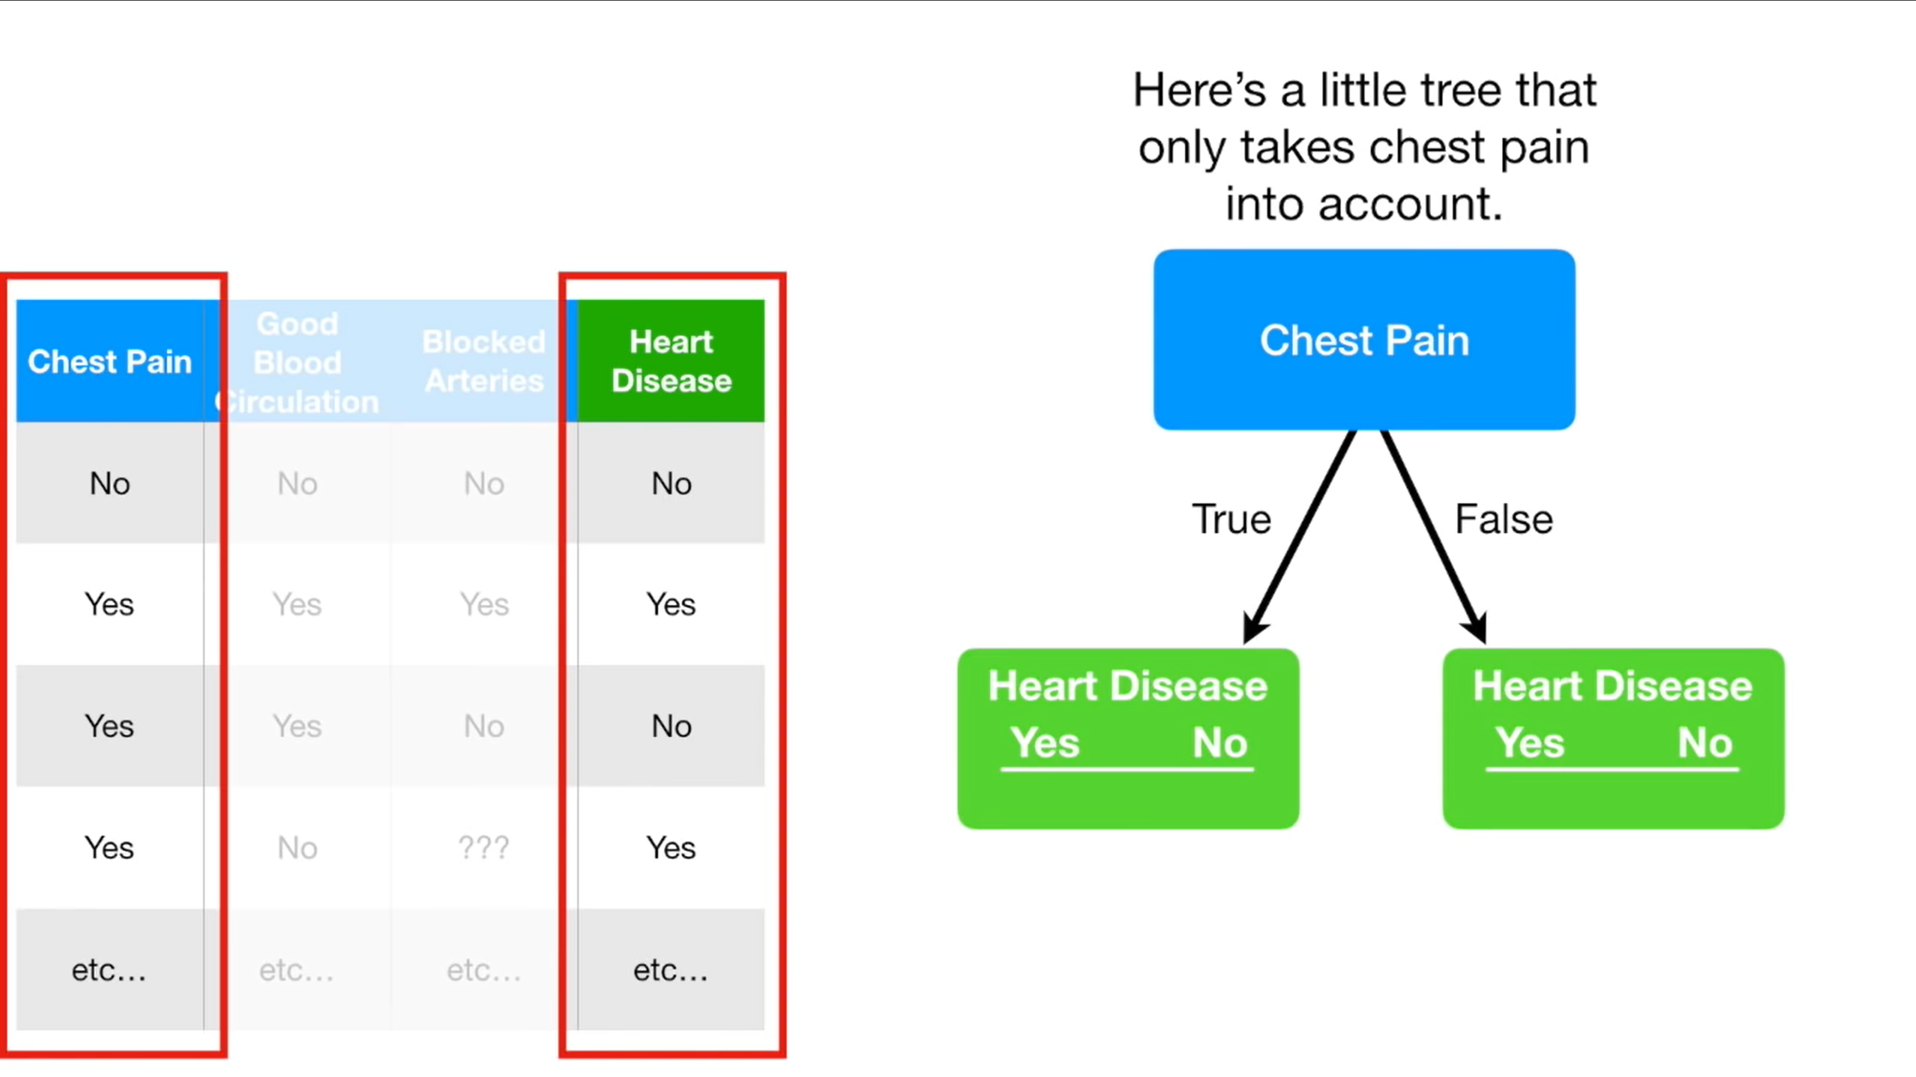

Slide 22
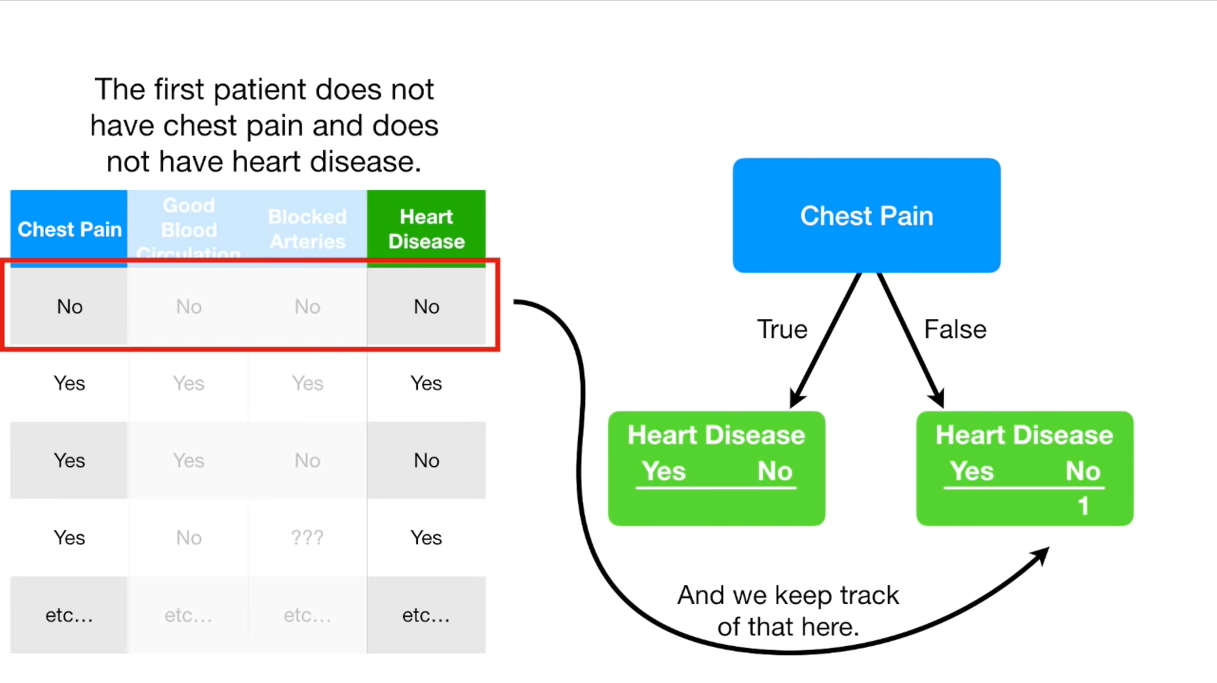

Slide 23
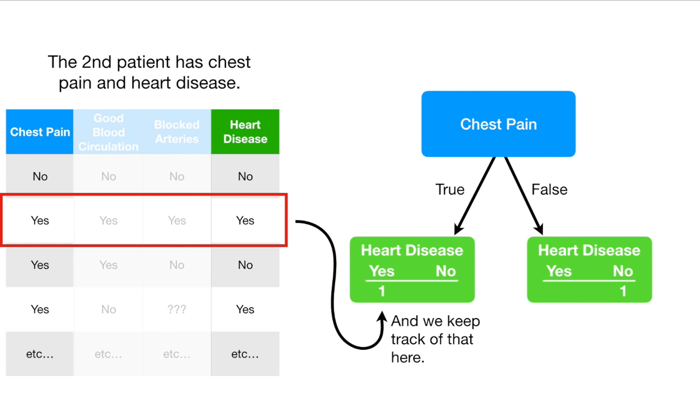

Slide 24
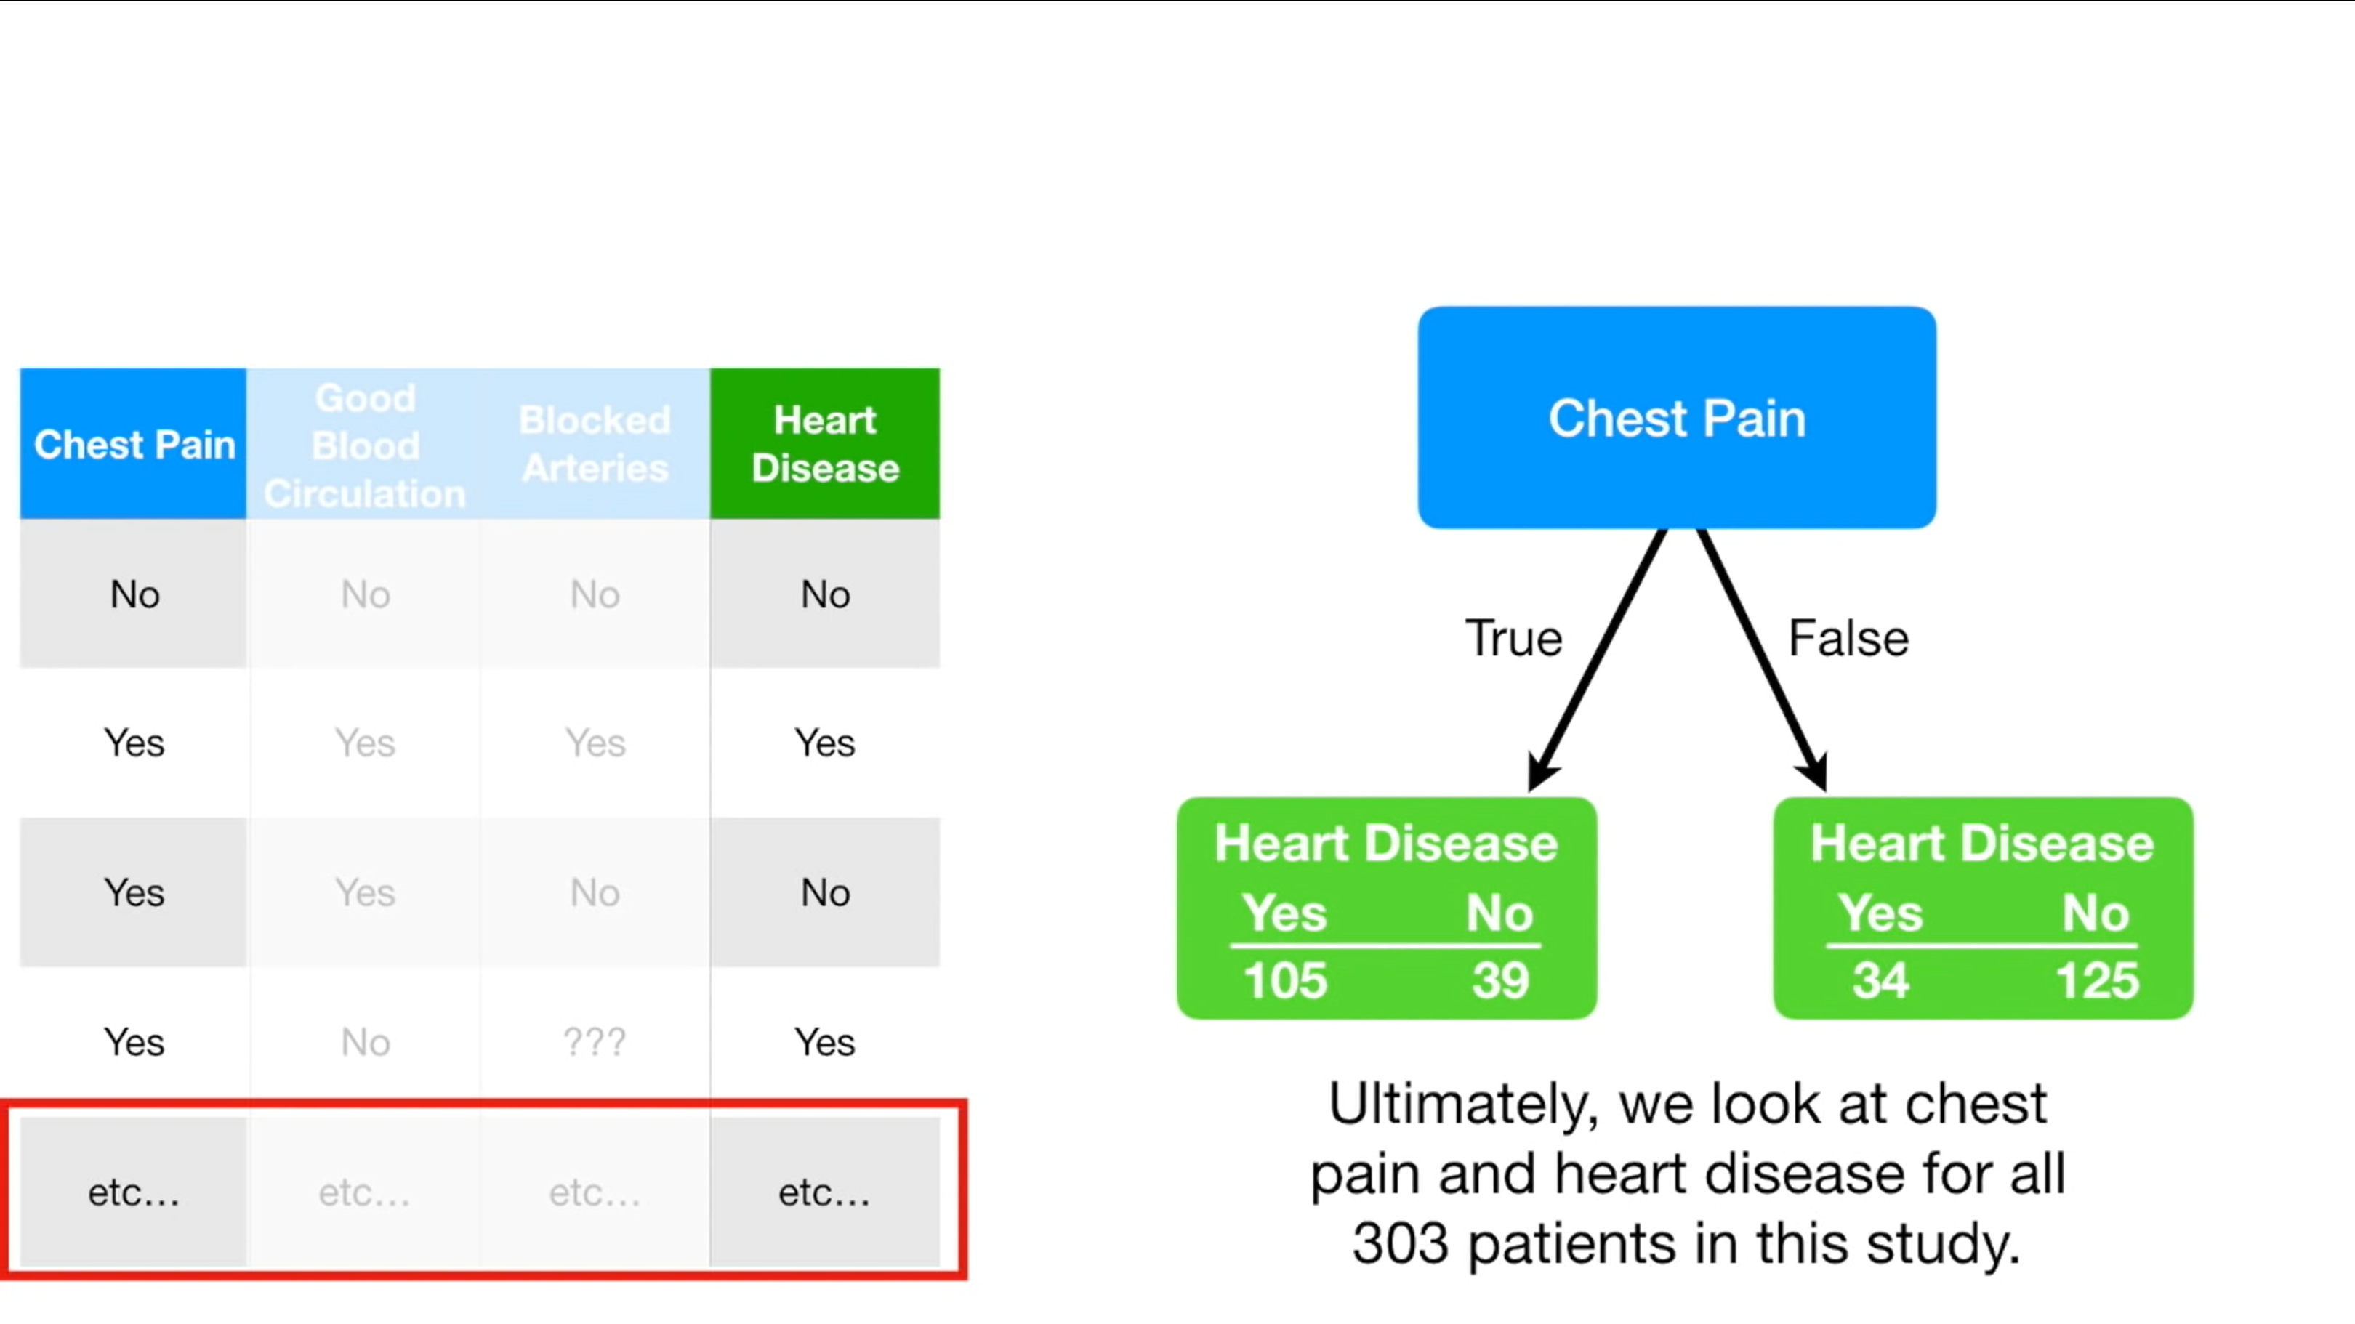

Slide 25
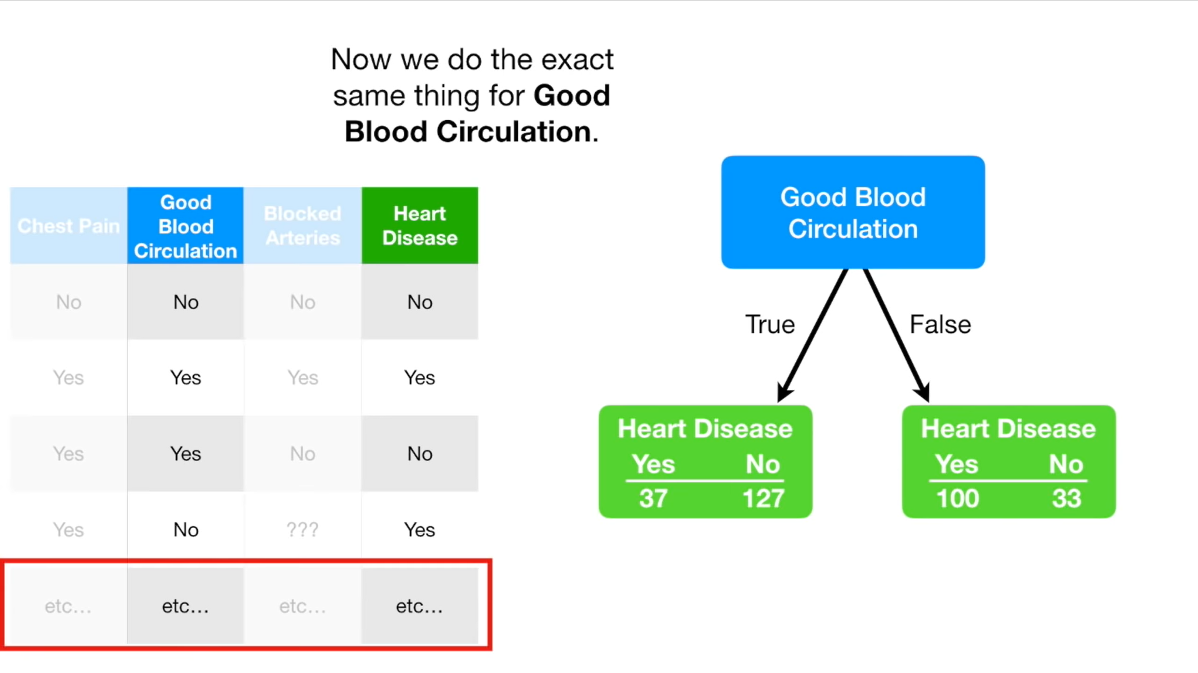

Slide 26
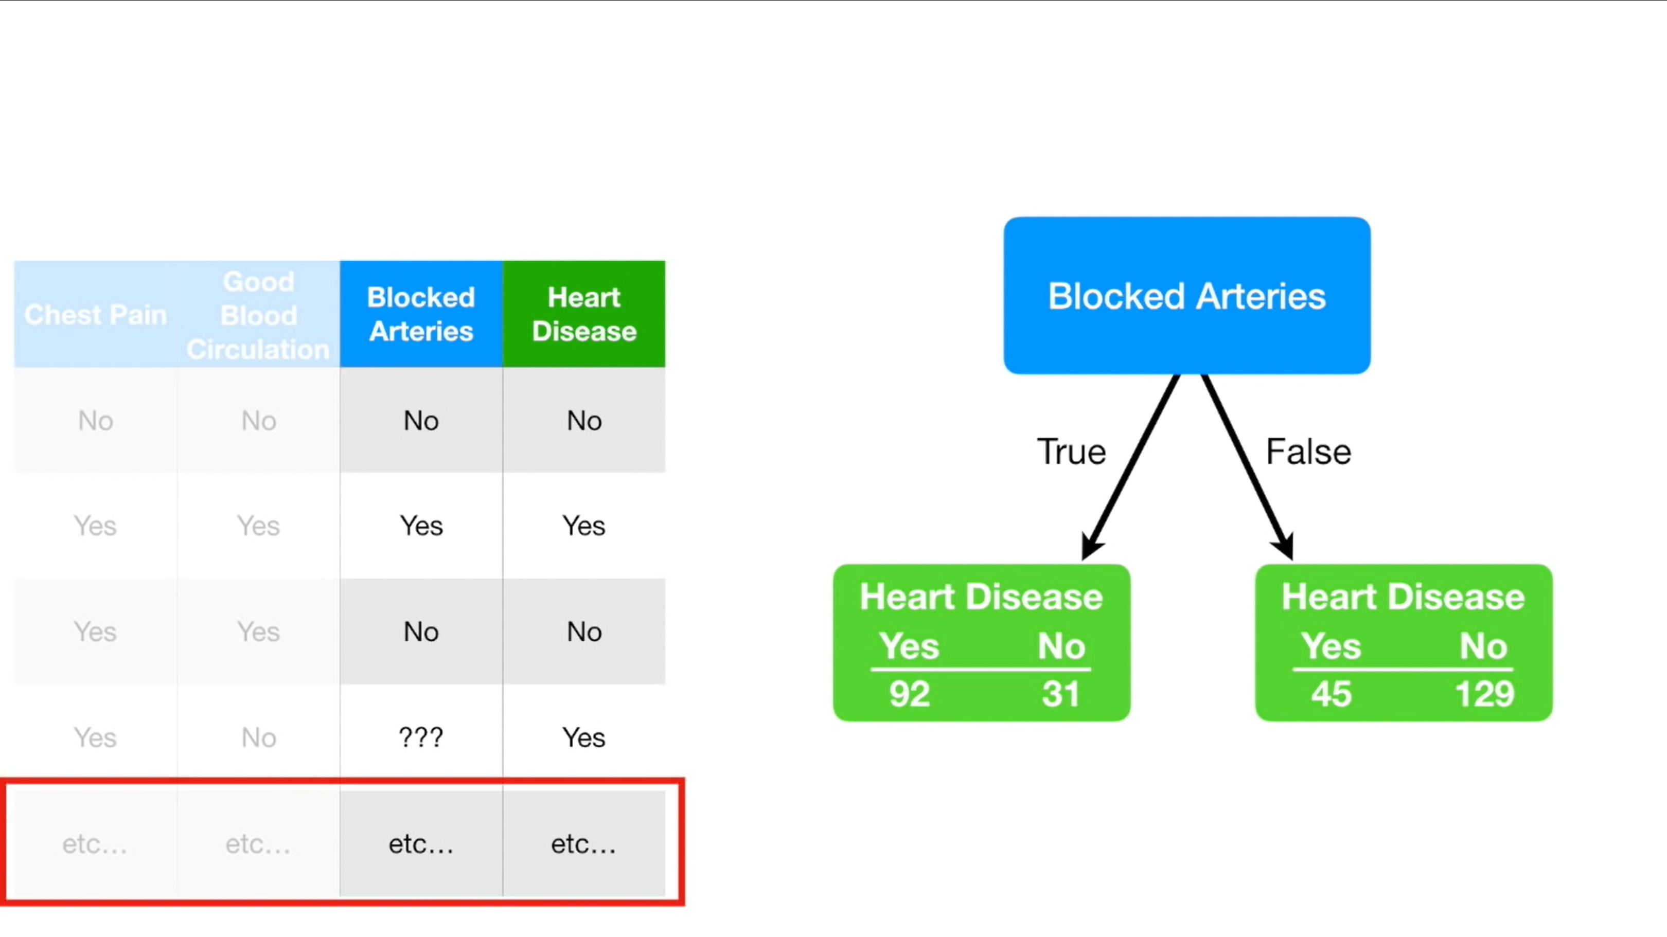

Slide 27
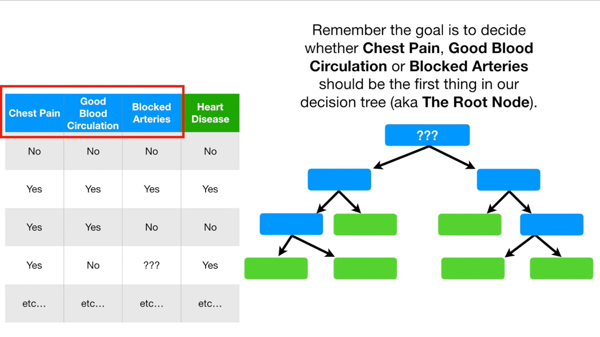

Slide 28
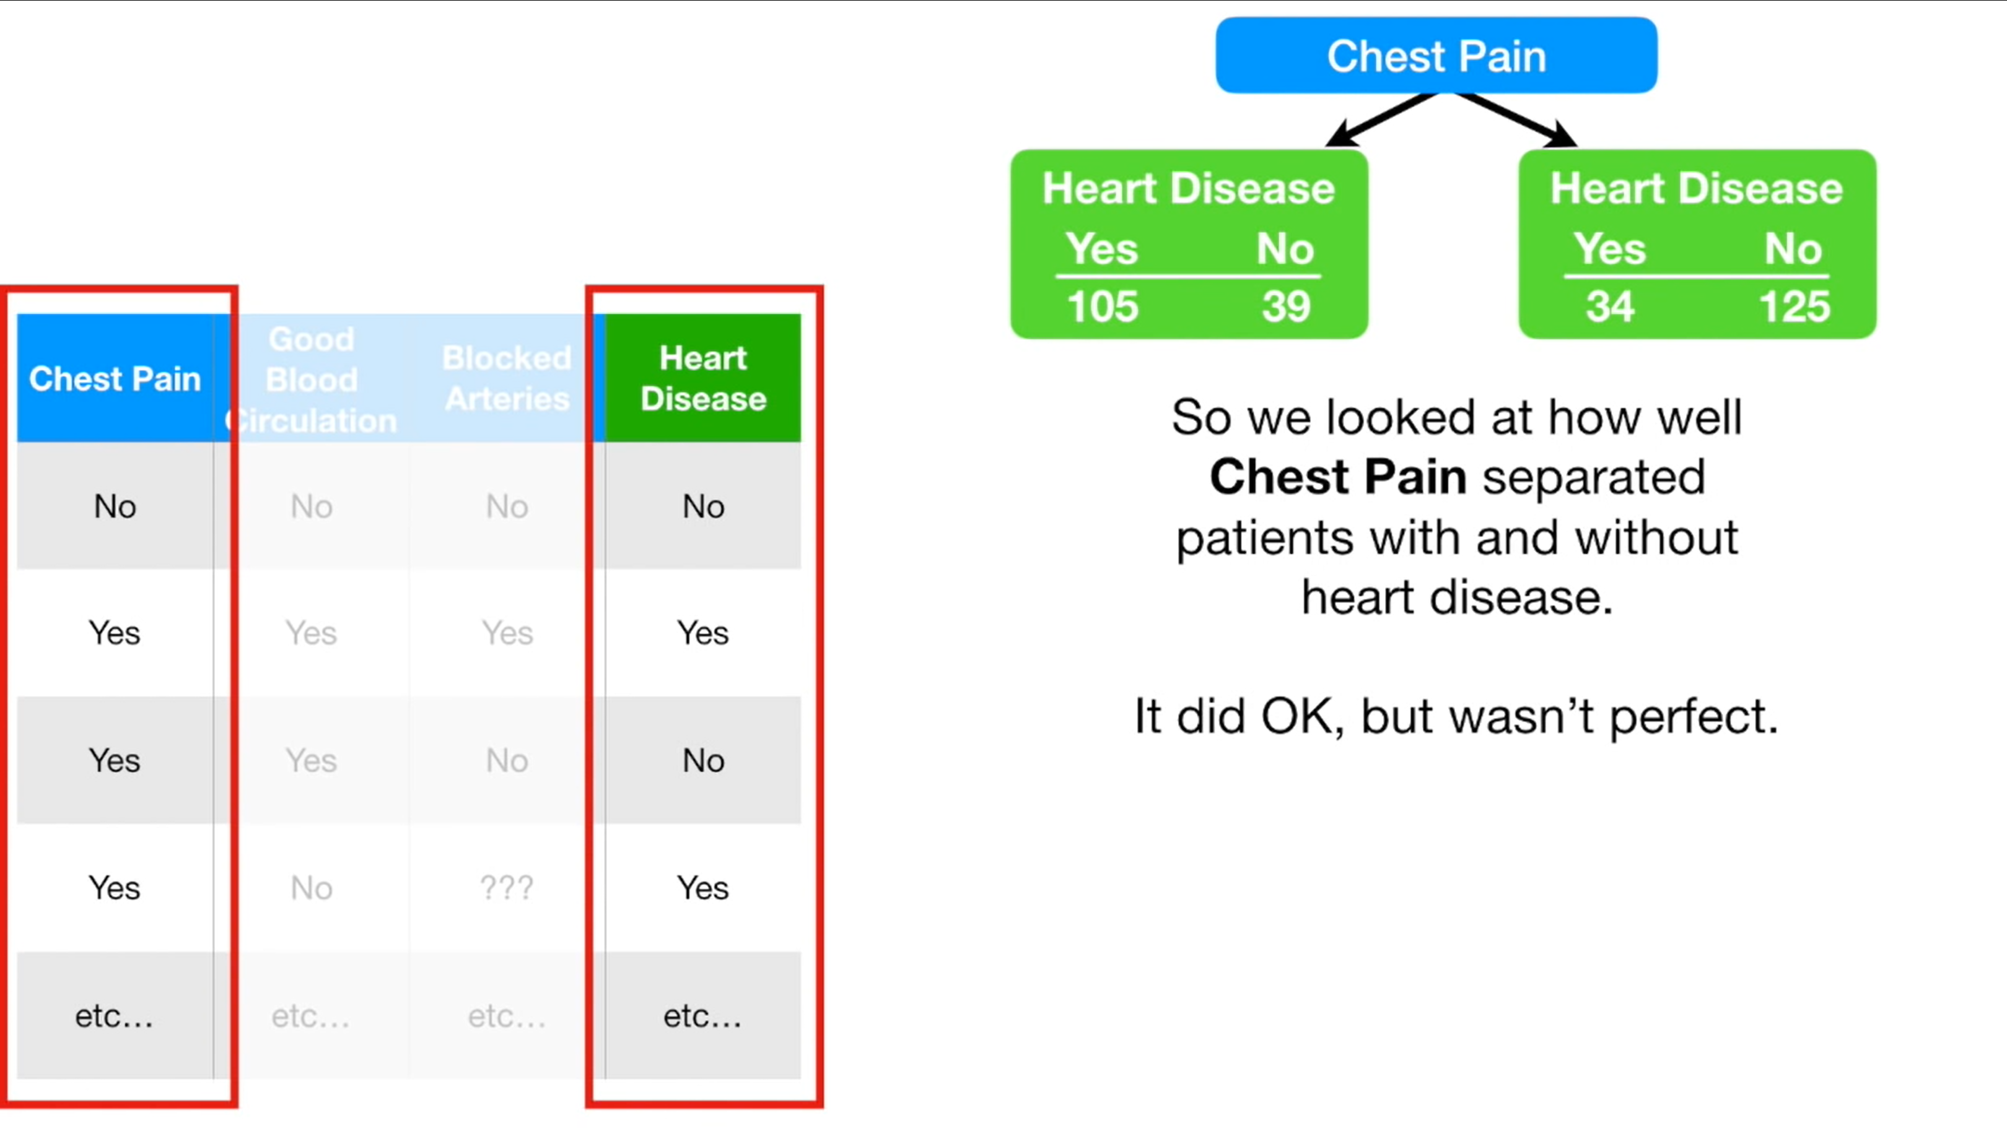

Slide 29
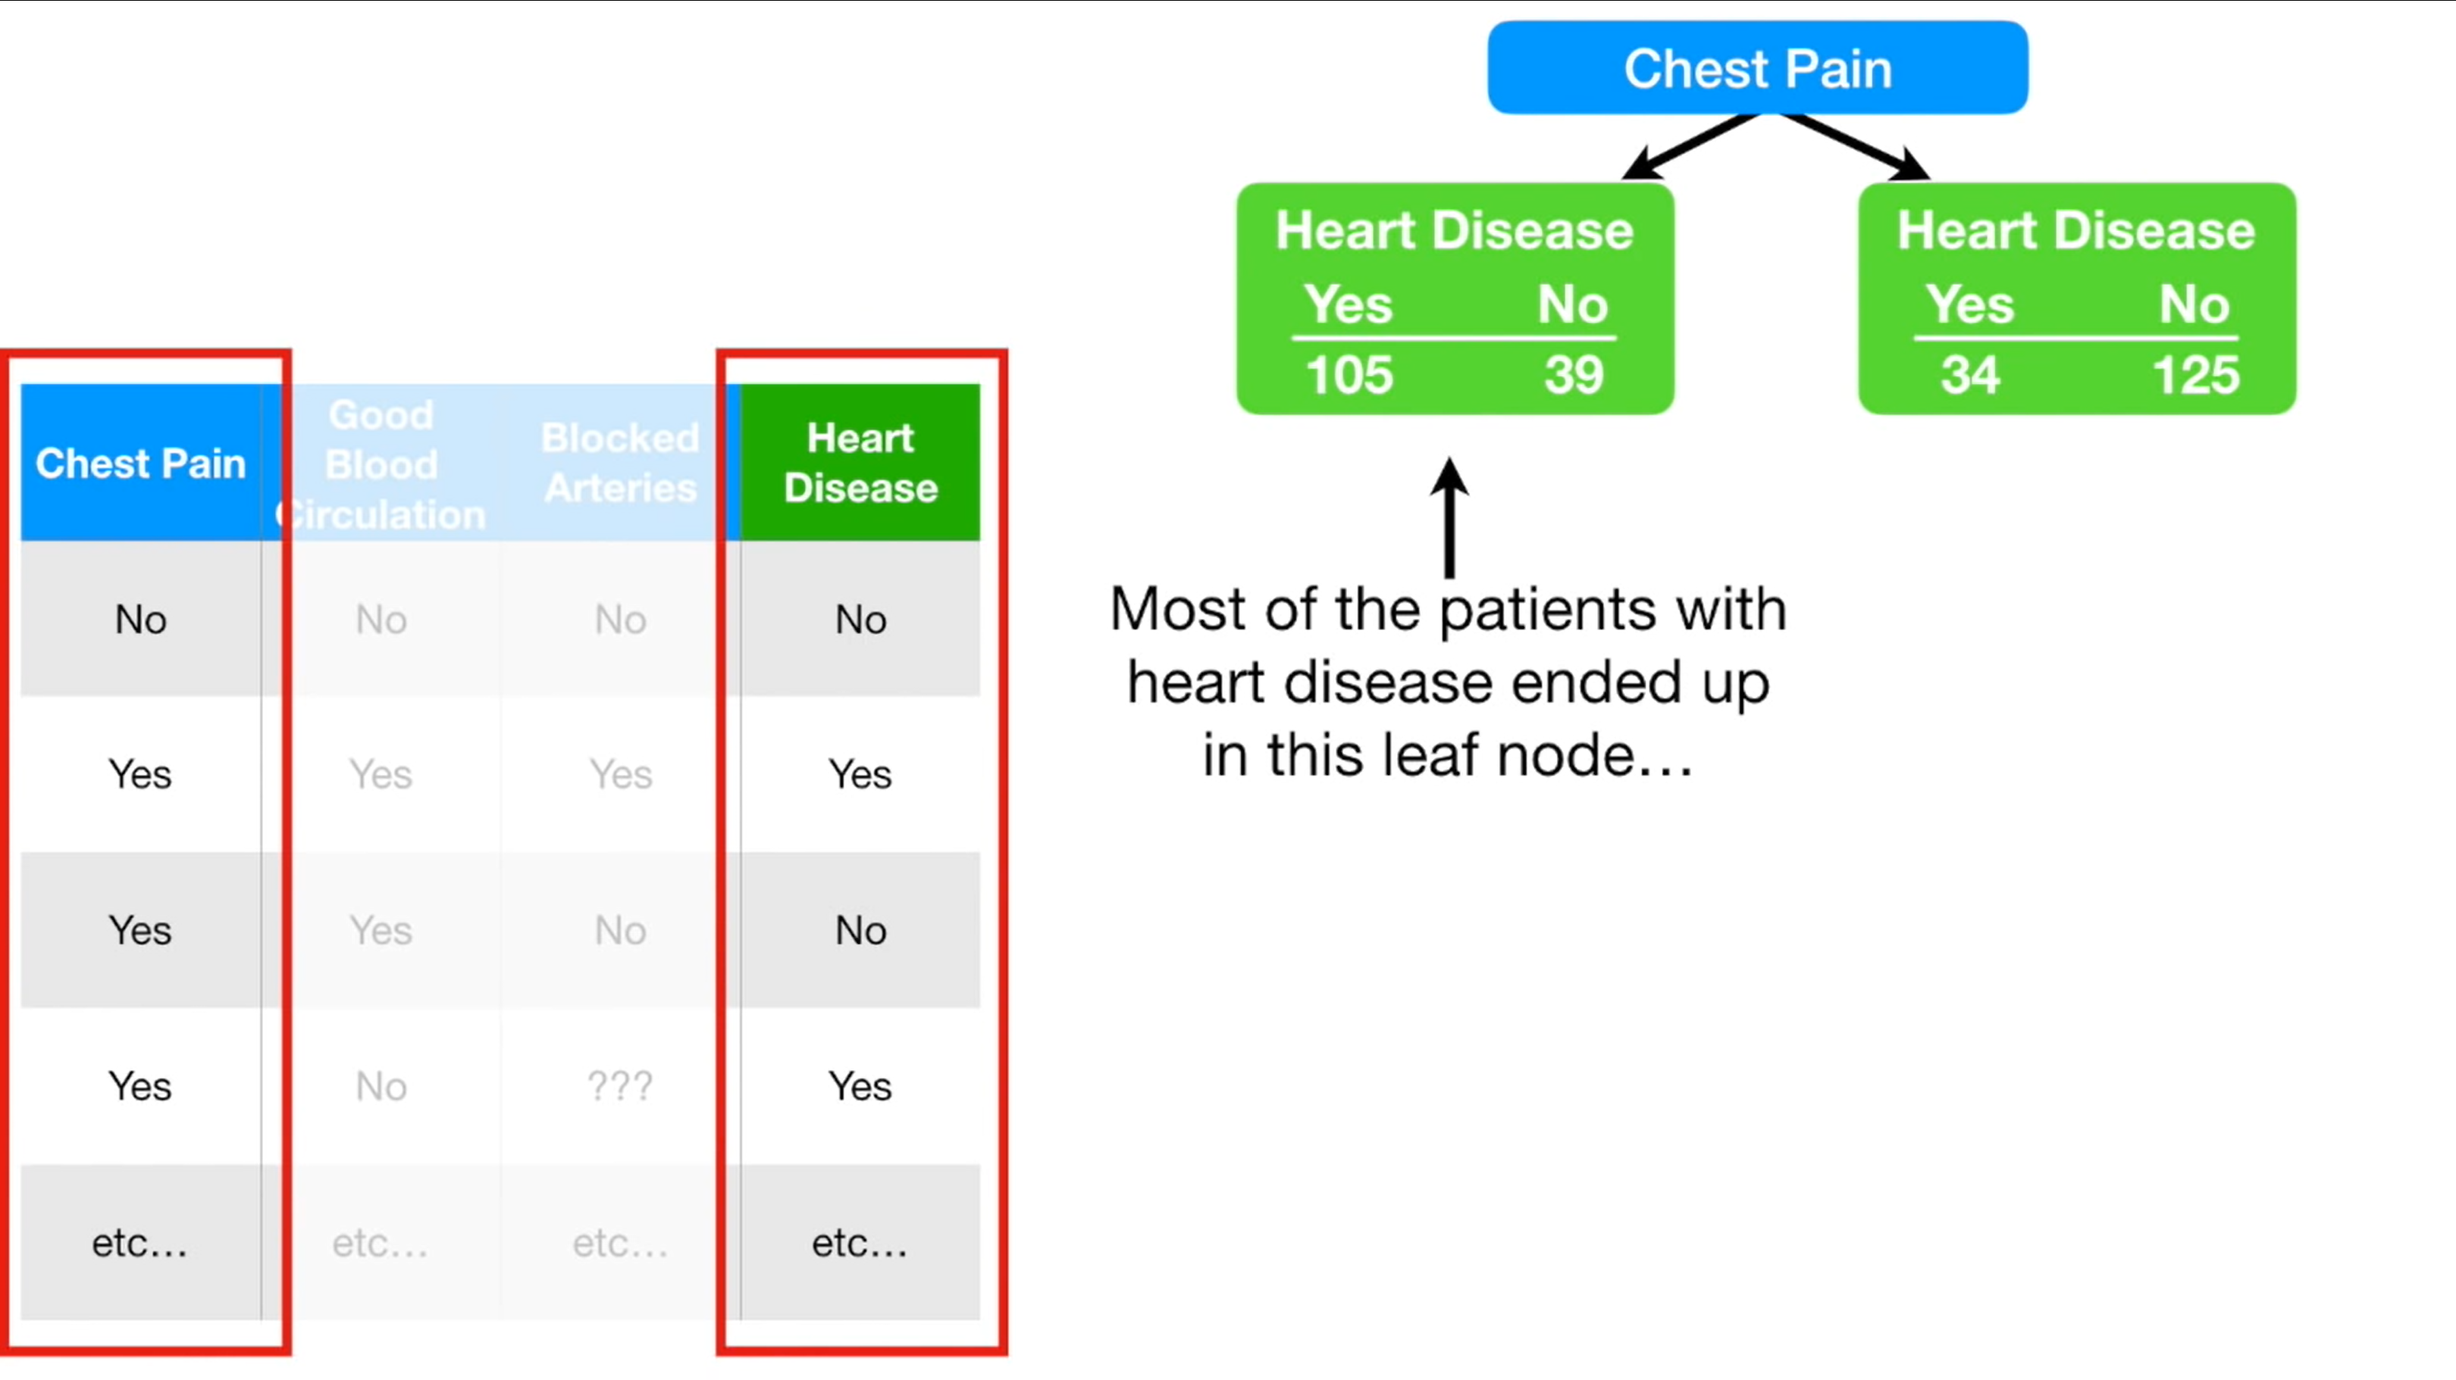

Slide 30
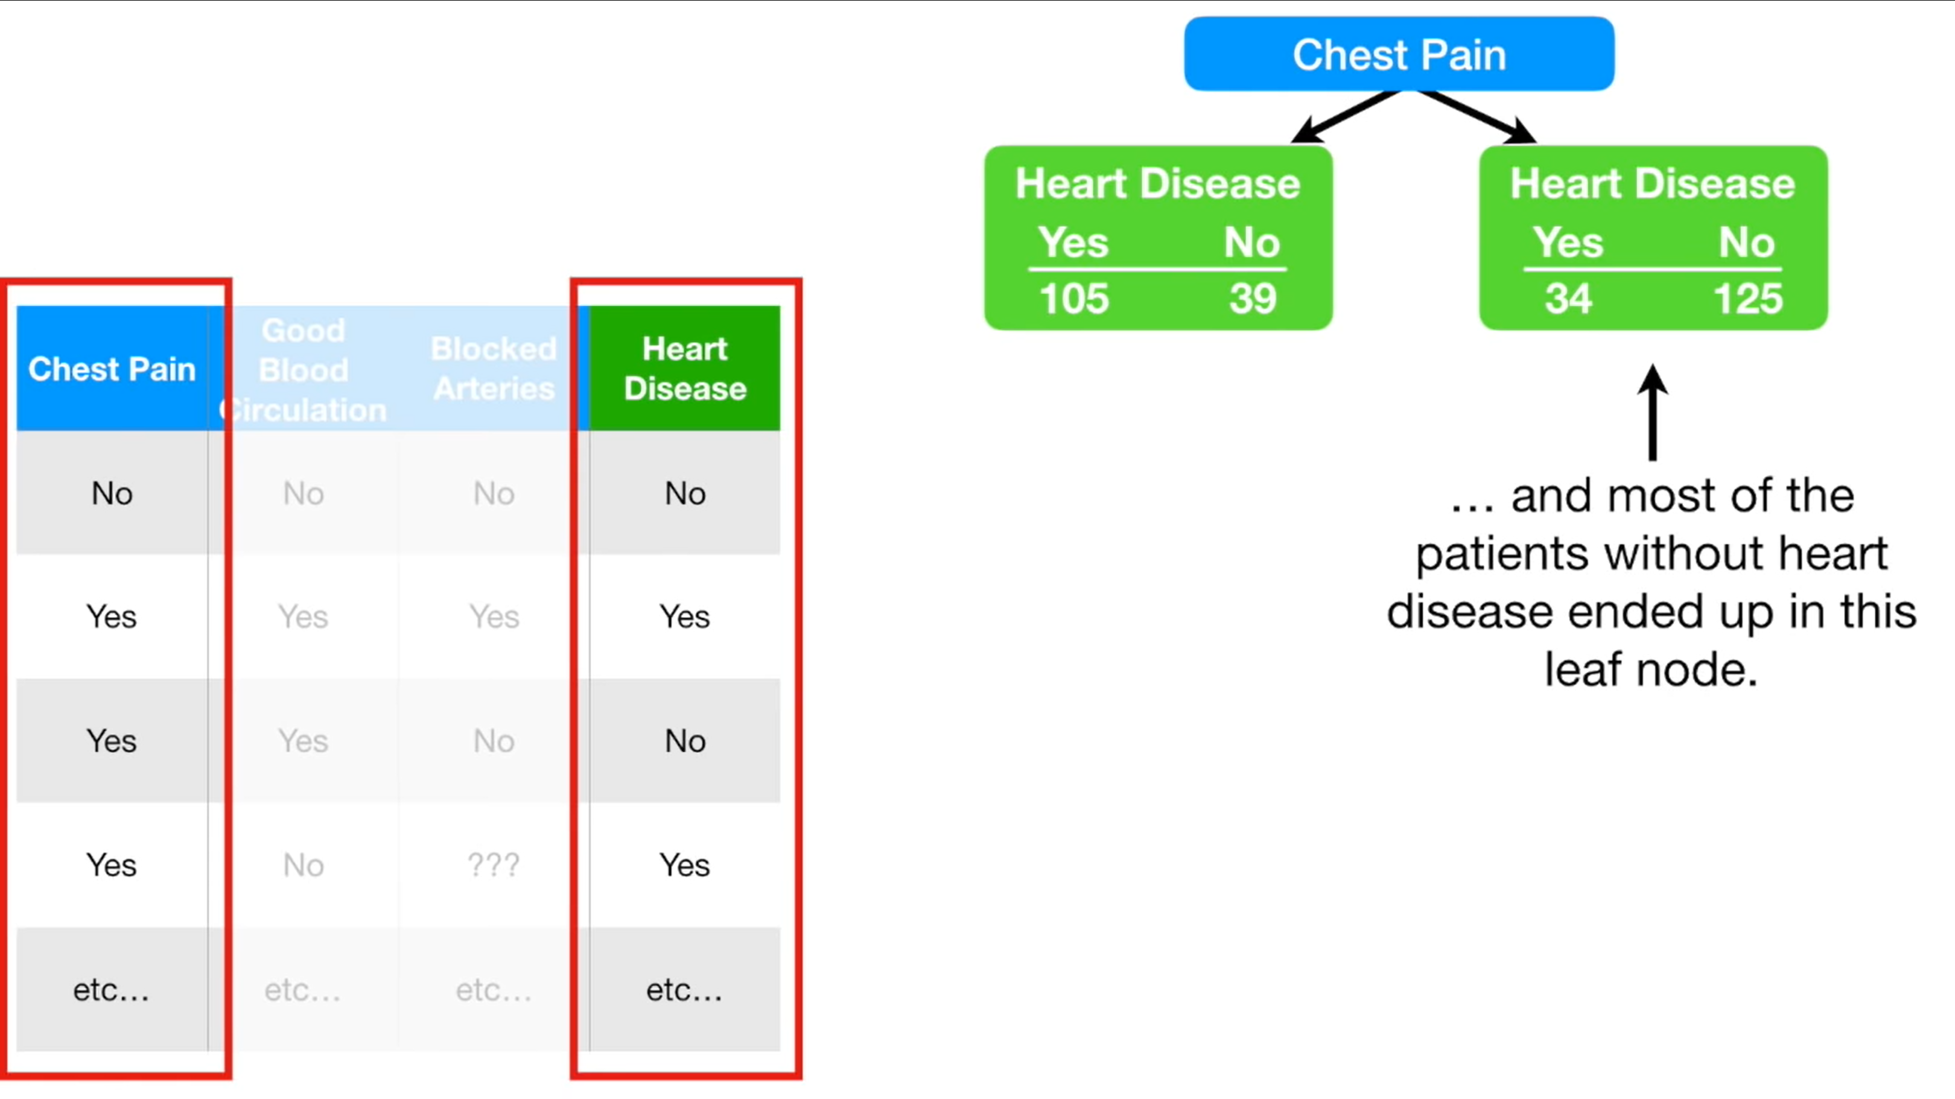

Slide 31
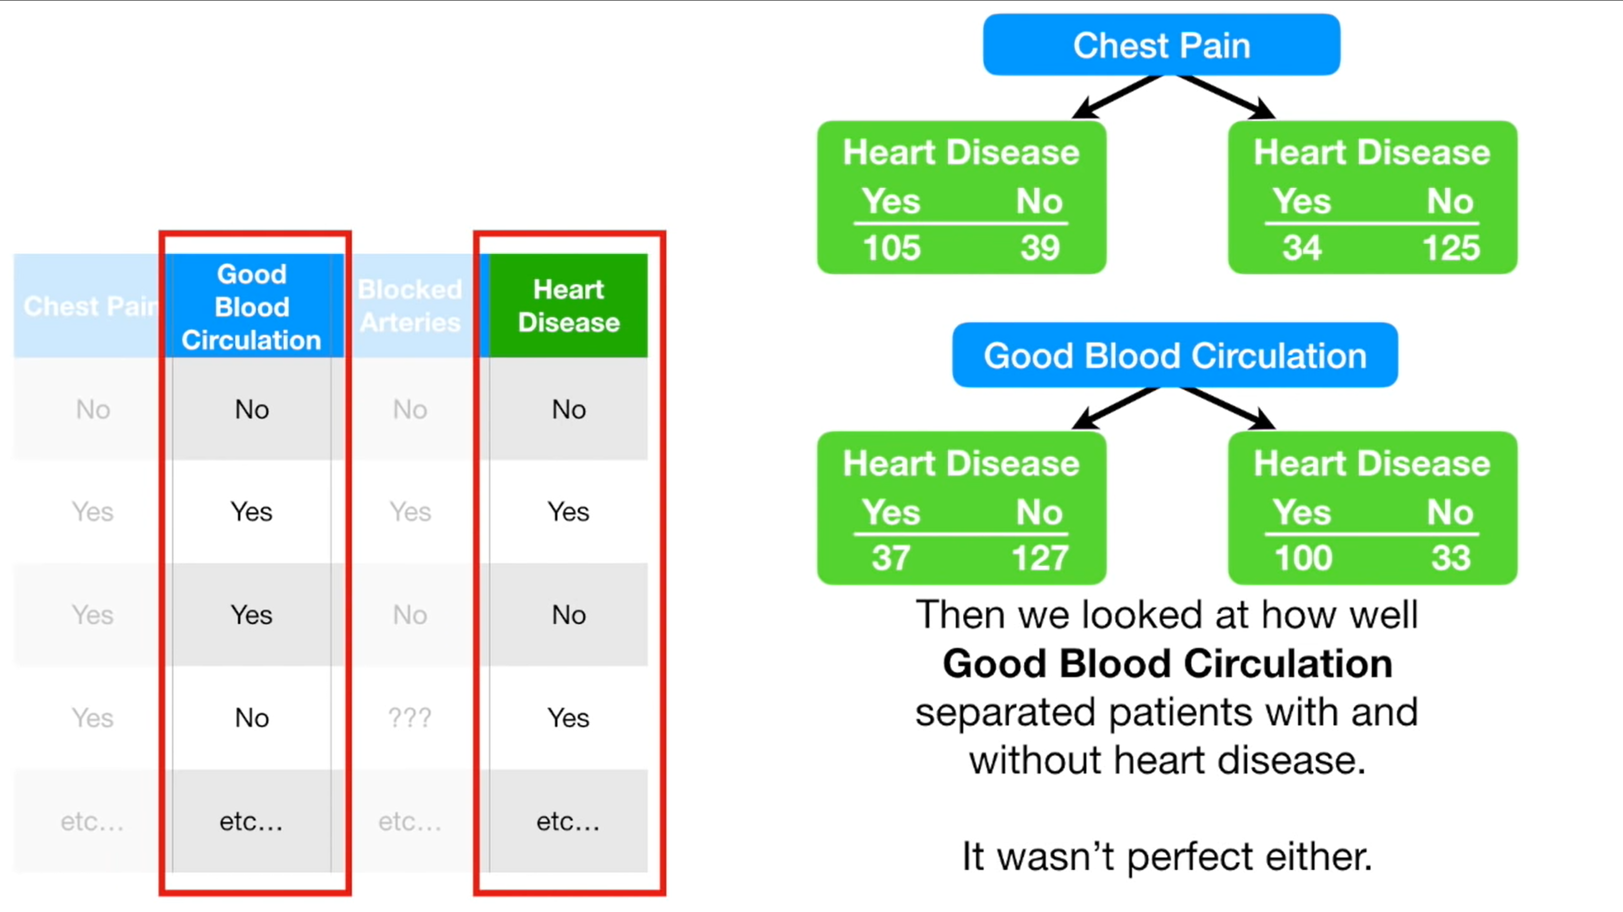

Slide 32
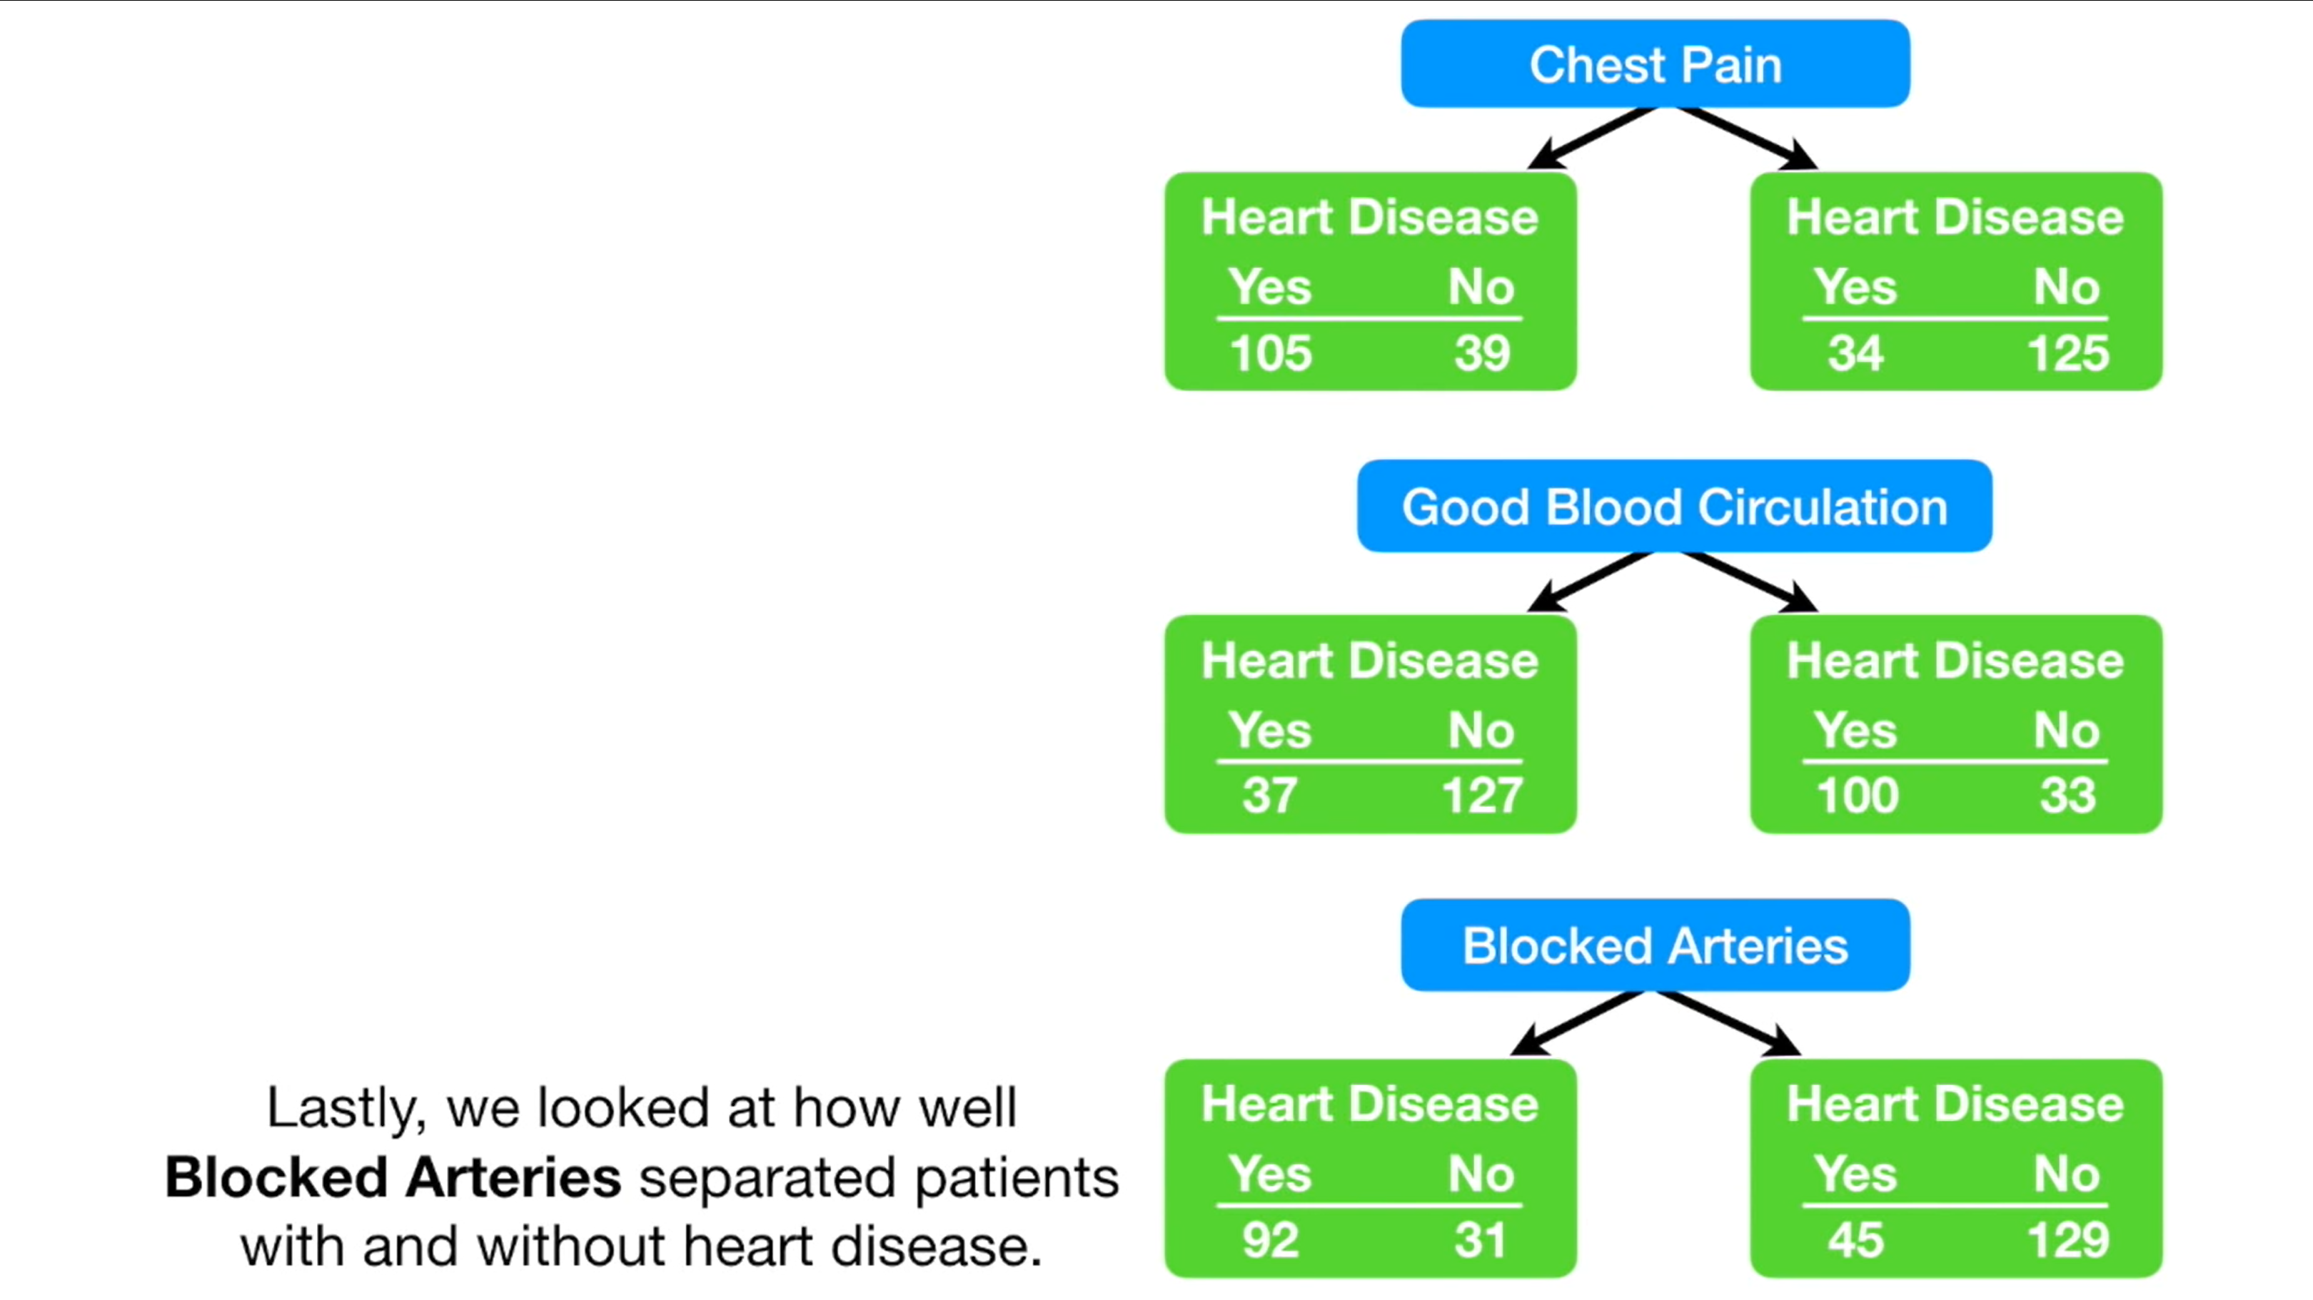

Slide 33
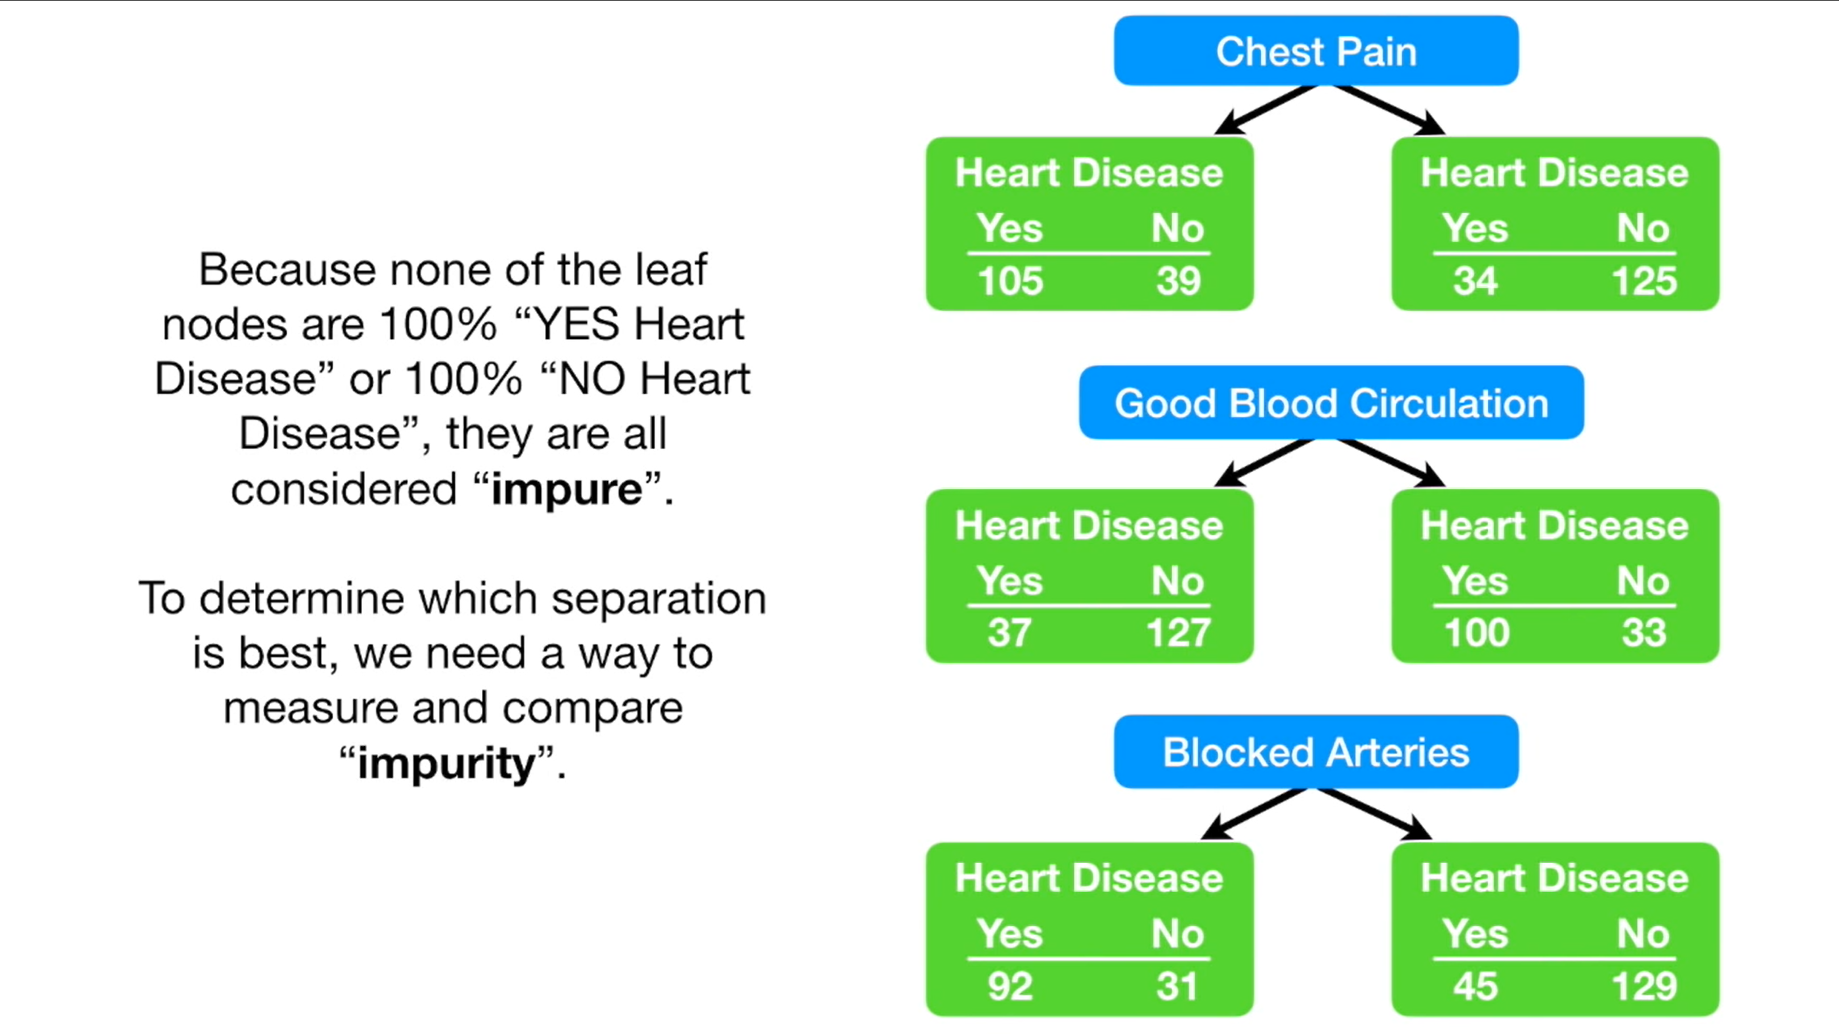

Slide 34
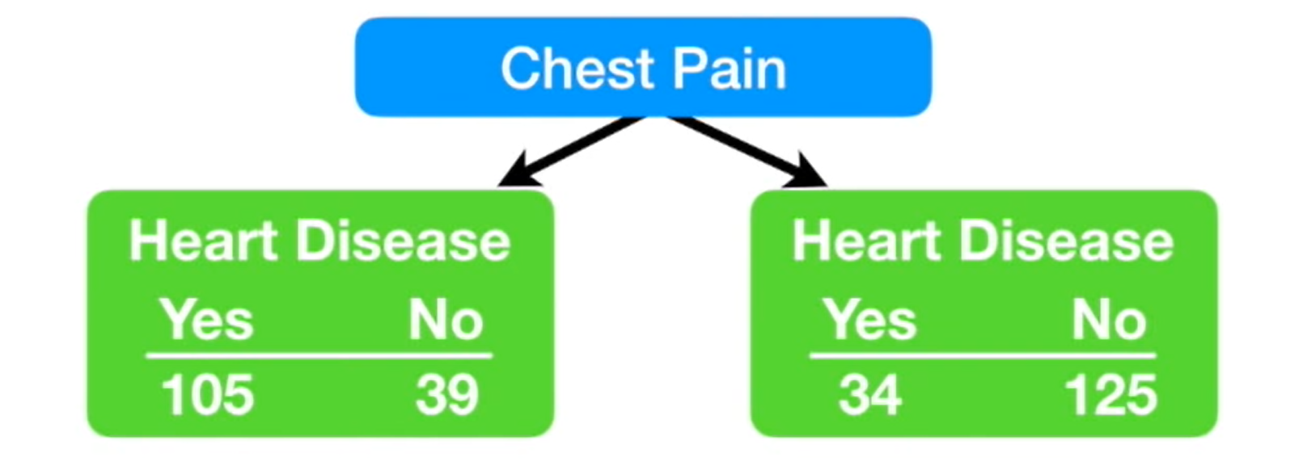
Fun Part! Calculation

Slide 35
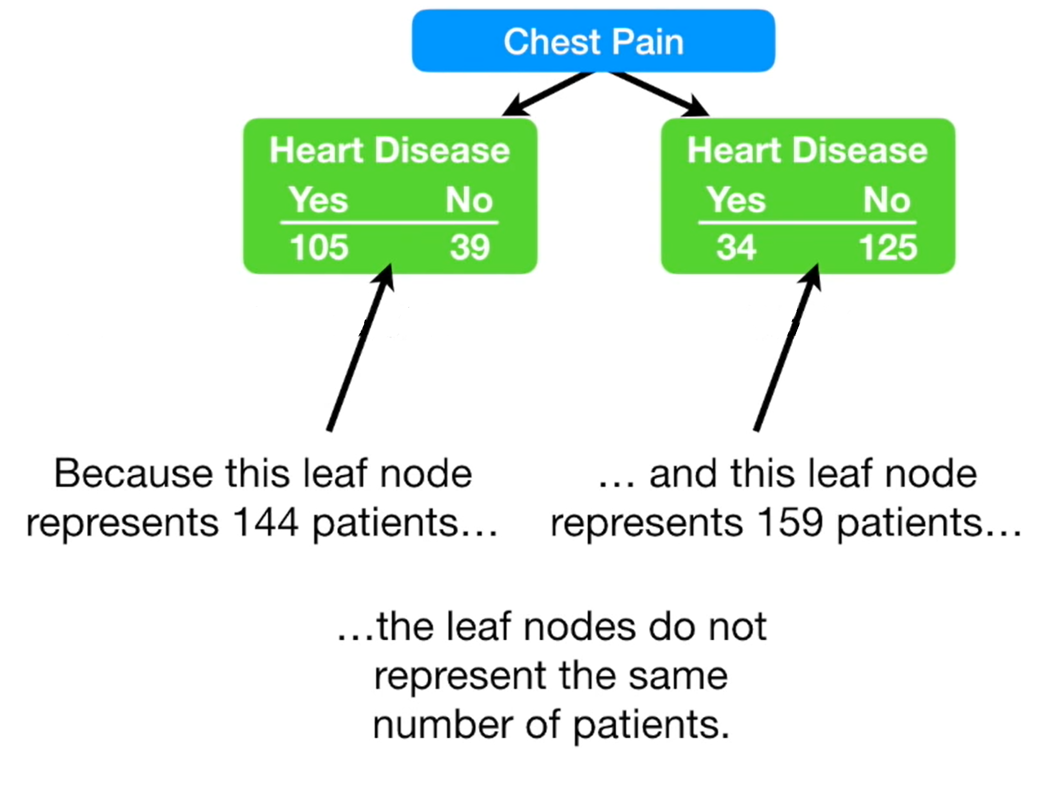
Fun Part! Calculation

Slide 36
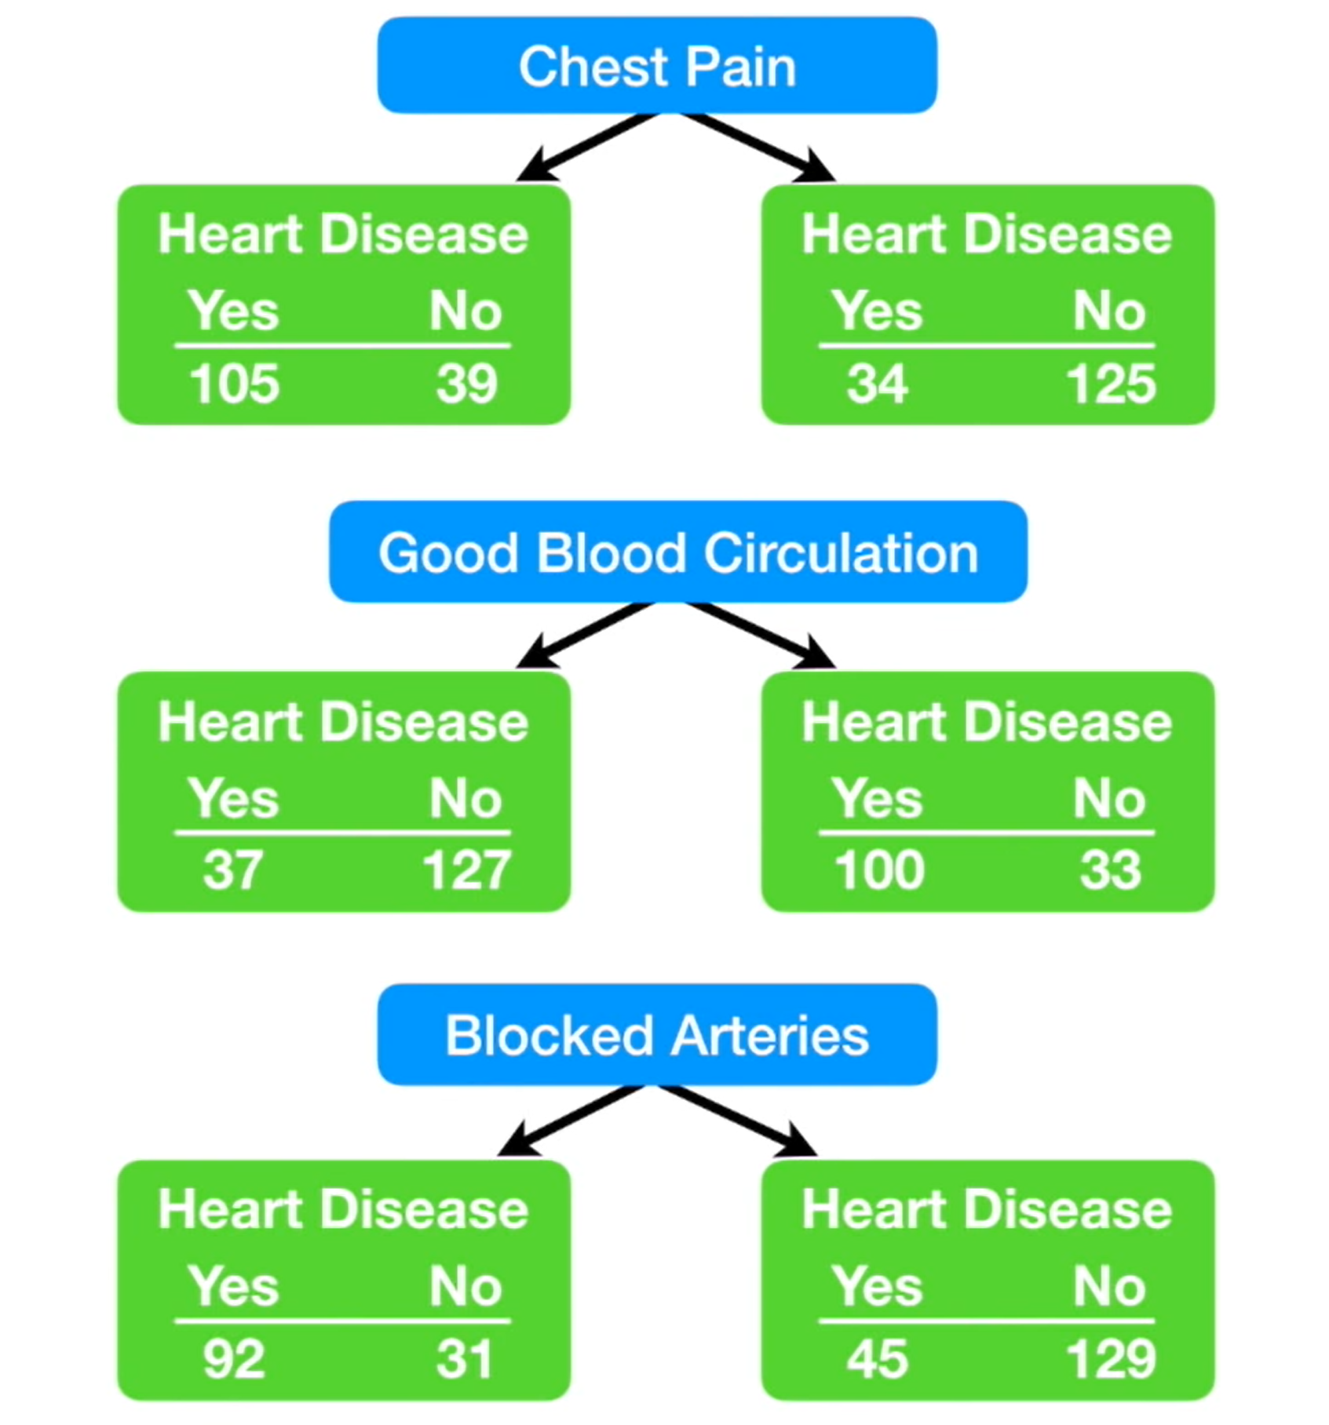
Fun Part! Calculation

Slide 37
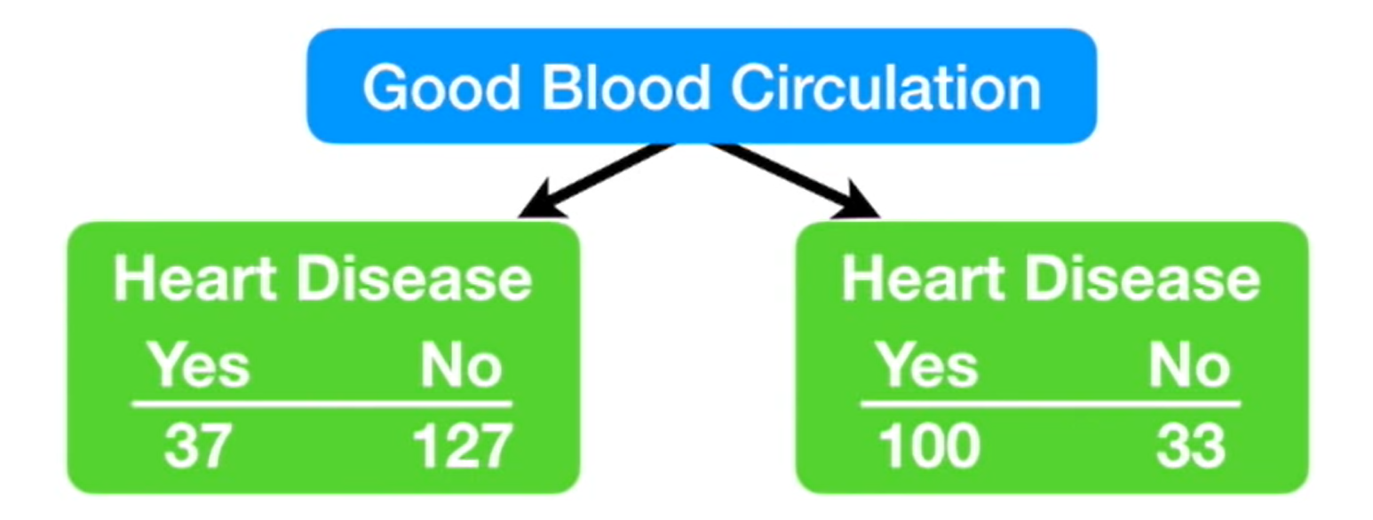
Pick this node!
The Good Blood Circulation has the lowest impurity (entropy)

Slide 38
Algorithms in R Code
CART: (rpart package) stands for Classification and Regression Tree.
It is characterized by the fact that it constructs binary trees, namely each node has exactly two edges. It handles both categorical and continuous variable.
CART Algorithm incorporates both testing with a test data set and cross-validation (cptable) to assess the goodness of fit more accurately.
The most frequently used measurements are entropy and Gini Index.
C.50: is the most recent and advanced algorithm invented by Quinlan. It handles both continuous and discrete attribute with improvement on speed, memory usage and support for boosting.
Its binary splitting criteria is based on entropy.
It produces smaller and interpretable trees with error-based pruning instead of complexity parameter pruning.

